Slide 1
What is South America like?
Geography - Seven Continents
Miss Harris
Notes:
I am so excited to begin today’s lesson! We have so far flown to 5 continents, this week we will be flying to South America and Antarctica. Largest rainforest in the WORLD
Blurb: In this lesson we are going to be virtually flying to South America which is in the southern hemisphere. First we will be filling our brains with facts about the population and how many countries are in South America. Then we will be learning about the physical features on this continent, it has lots of different elements! We will then be looking more in depth into the Amazon rainforest which is located in this wonderful continent.
Can you hear the animals here?

Slide 2
Seven Continents 100% Sheet
This is your 100% sheet, it includes all the wonderful knowledge we are learning about in this unit.
Practise learning the key facts, it will help you in future lessons
Use it to make flash cards
See if you can learn all of the facts quicker than your parent or carer!

Slide 3
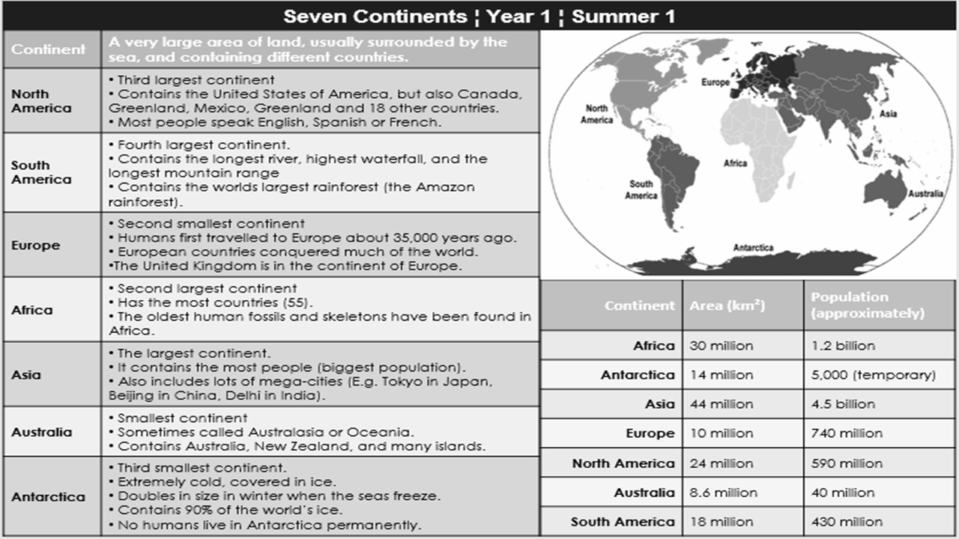
largest
(54)

