Slide 1
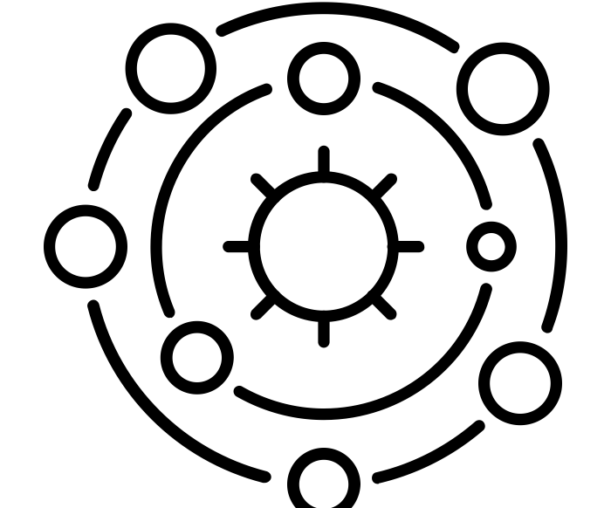
What is the solar system?
Science - Space
Miss Hummel
solar system by Andrei Yushchenko from the Noun Project
Notes:
Hi everyone! My name is Miss Hummel and together, we will be answering the question: What is the solar system?
In this lesson we will discuss what we can find in our solar system. We will also discuss what a planet, moon and space dust is. Finally, we will examine the differences between Asteroids, Meteoroids, Meteors and Meteorites.

Slide 2
Complete this task
Try and create a mind map of a sun. Include as much information about the sun as you can remember!
🌣
Notes:
Image from Oak illustrator
I would now like you to pause the video to answer these questions
What is a simple machine?
What are the three types of simple machines we need to know?
Resume once you are finished answering the questions.

Slide 3
Actions to remember:
Try and come up with some actions to remember this definition:
Planets are large pieces of rock in the shape of a sphere.
Notes:
You are now going to pause the video to label the diagram with the parts of the lever.

Slide 4
Write the names of the object from the solar system being described below:
- the largest object in the solar system that the solar system was named after
- large spheres of rock that orbit around the sun
- large balls of rock that orbit planets
- an example of another rocky object that can be found in the solar system
- leftover material from stars that have exploded in the past
Notes:
Image from Oak illustrator
I would now like you to pause the video to answer this question
What are three examples of things that use pulleys?
Resume once you are finished answering the question.

Slide 5
Linking Knowledge: Complete the match up task below to revise your knowledge of days, seasons and years.
1 day Summer time Winter time 1 year |  | When the part of the Earth you are on is tilted towards the Sun. The time it takes for the Earth to complete one rotation. The time it takes for the Earth to orbit the Sun. When the part of the Earth you are on is tilted away the Sun.
Notes:
Image from Oak illustrator
I would now like you to pause the video to answer this question
What are three examples of things that use pulleys?
Resume once you are finished answering the question.

Slide 6
Answers:
1 day Summer time Winter time 1 year |  | When the part of the Earth you are on is tilted towards the Sun The time it takes for the Earth to complete one rotation. The time it takes for the Earth to orbit the Sun. When the part of the Earth you are on is tilted away the Sun.
Notes:
Image from Oak illustrator
I would now like you to pause the video to answer this question
What are three examples of things that use pulleys?
Resume once you are finished answering the question.

Slide 7
Answer the questions:
What are asteroids?
How is the orbit of an asteroid different to the orbit of a planet?
Notes:
Image from Oak illustrator
I would now like you to pause the video to answer this question
What are three examples of things that use pulleys?
Resume once you are finished answering the question.

Slide 8
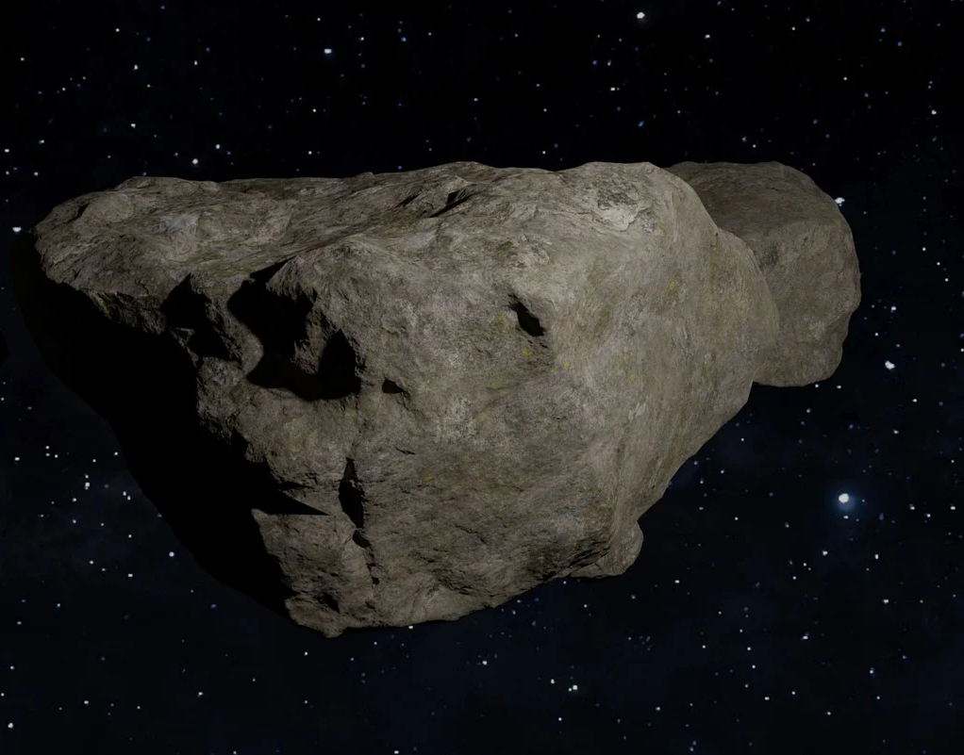
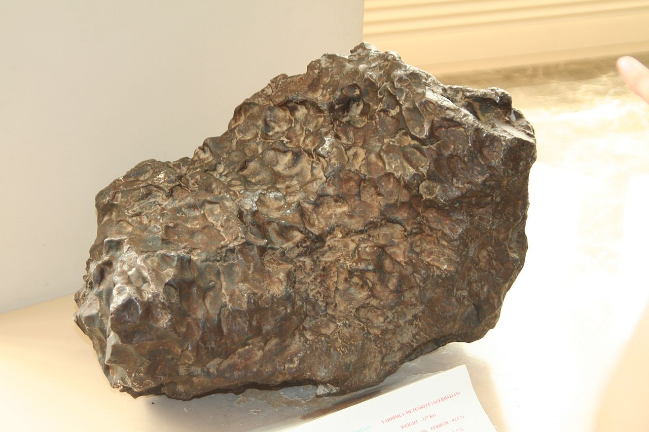
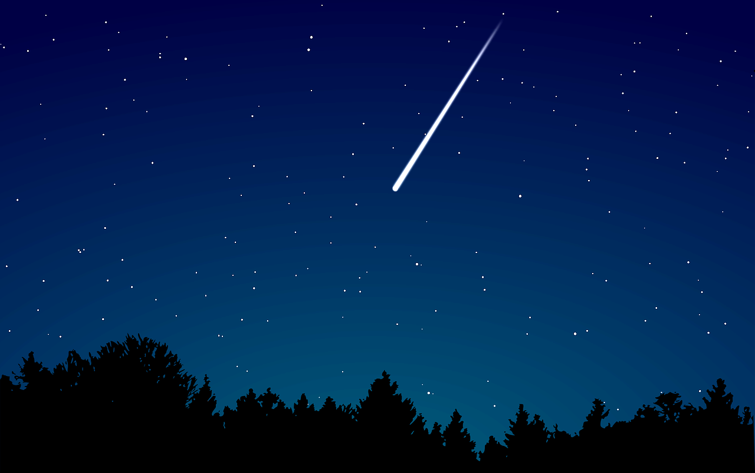
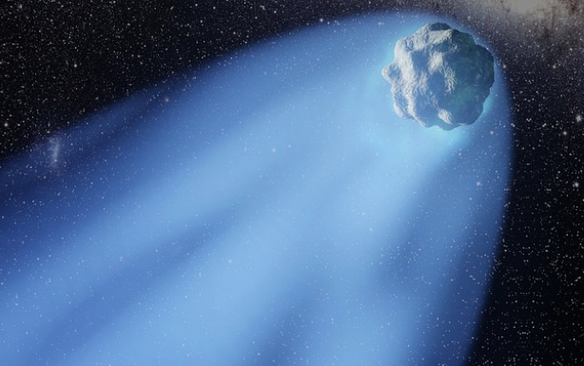
Label the diagram below with the correct names from the list below
Meteor | Meteorite | Asteroid | Comet
Yardymly (meteorite), Interfase, Wikimedia Commons
Notes:
Image from Oak illustrator
I would now like you to pause the video to answer this question
What are three examples of things that use gears?
Resume once you are finished answering the question.

Slide 9
Thinking Task:
Meteors do not always reach the Earth to become meteorites. Think about why you think this is the case.
Notes:
I would now like you to pause the video to answer this question
What are three examples of things that use gears?
Resume once you are finished answering the question.

