Slide 1
Mathematics
Division Worksheet
Mrs Buckmire

Slide 2
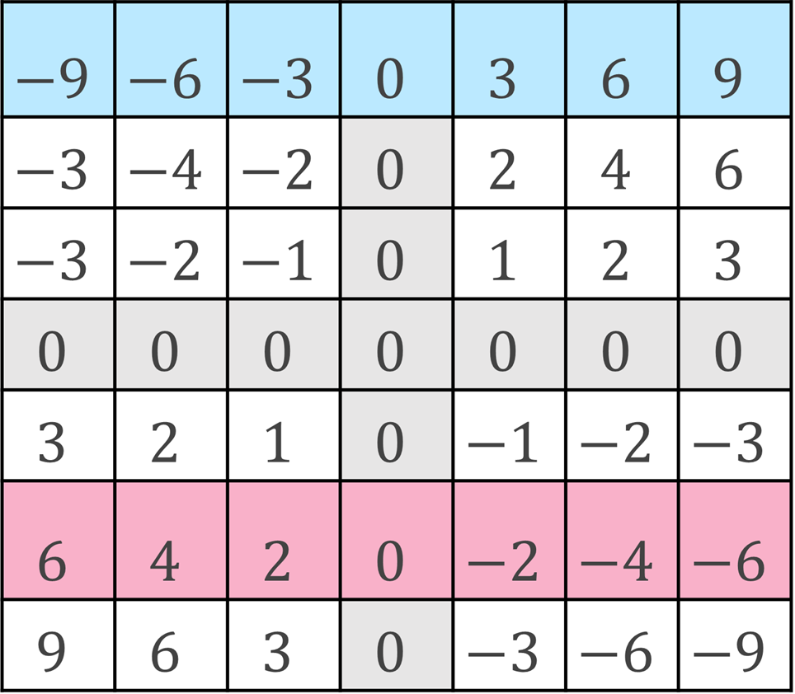
Try this
<-Blue row
Write each of the numbers in the blue row as:
3 x
Write each of the numbers in the red row as:
-2 x
Write each of the other rows as a multiple of an integer.
<-Red row
Return to the video once completed

Slide 3
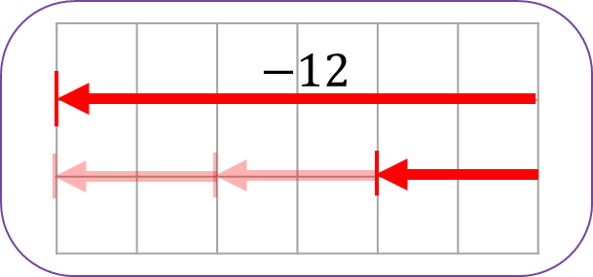
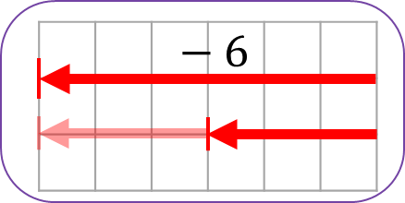
Connect
These calculations can be connected to this image:
Write a similar set of four calculations this image:
Return to the video once completed

Slide 4
Independent task (page 1)
1. Copy and complete the related calculations
Return to the video once completed

Slide 5
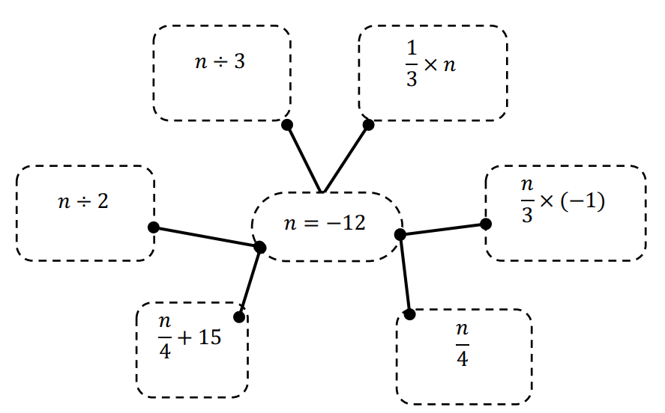
Independent task (page 2)
2. Evaluate each of the expressions below with the value of n at the centre of the network
Return to the video once completed

Slide 6
Explore
Return to the video once completed

