Slide 1
Fractions
Solve fraction problems with the four operations.
Independent Task
Mathematics

Slide 2
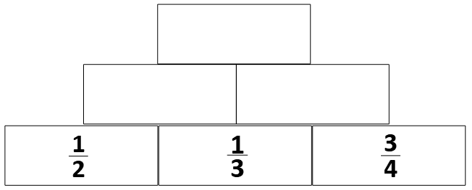
Question 1
Each block is the product of the two below.
Can you complete the pyramid?

Slide 3
Question 2

Slide 4
Question 3

Slide 5
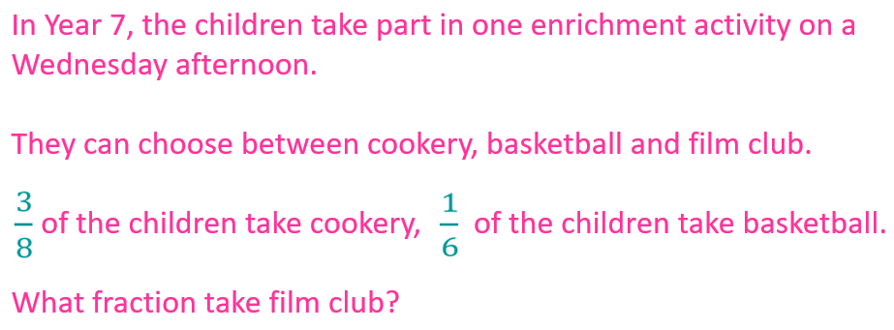
Question 4

Slide 6
Question 5
I am training for a 10k run.
Last week, I ran kilometres each day.
How many kilometres did I run altogether?

