Slide 1
What makes something pure?
Worksheet
Science
Miss Couves
Notes:
Silent - 5 seconds
Full face intro (welcome, introduce self, introduce lesson)

Slide 2
What do the particles look like in ice, water and steam?
Ice
Water
Steam

Slide 3
What do the particles in wood look like?
Questions to ask:
Is the substance a solid, a liquid or a gas?
Should the particles touch?
Should the particles be ordered?
Should the particles be moving fast?

Slide 4
What do the particles in oil look like?
Questions to ask:
Is the substance a solid, a liquid or a gas?
Should the particles touch?
Should the particles be ordered?
Should the particles be moving fast?

Slide 5
What do the particles in helium look like?
Questions to ask:
Is the substance a solid, a liquid or a gas?
Should the particles touch?
Should the particles be ordered?
Should the particles be moving fast?

Slide 6
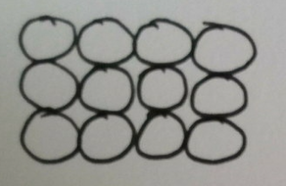
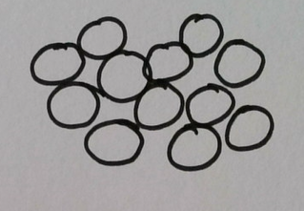
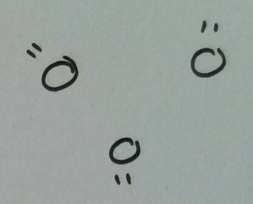
Annotate the diagrams with how do the particles behave in solids, liquids and gases?
Solids
Liquids
Gases

Slide 7
How do the particles in oil behave?
Option 1
Option 2
They are touching and vibrating on the spot.
They are touching but can slide past each other.
Option 3
Option 3
Option 4
Option 4
They are not touching and move very quickly in all directions.
They are touching but not moving at all.

Slide 8
How do the particles in wood behave?
Option 1
Option 2
They are touching and vibrating on the spot.
They are touching but can slide past each other.
Option 3
Option 3
Option 4
Option 4
They are not touching and move very quickly in all directions.
They are touching but not moving at all.

Slide 9
How do the particles in helium behave?
Option 1
Option 2
They are touching and vibrating on the spot.
They are touching but can slide past each other.
Option 3
Option 3
Option 4
Option 4
They are not touching and move very quickly in all directions.
They are touching but not moving at all.

Slide 10
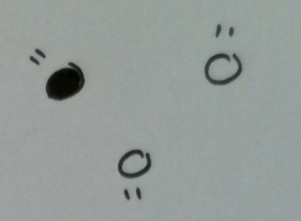
Which substance is pure and which is impure?
Helium
Air

Slide 11
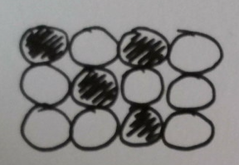
Which substance is pure and which is impure?
Gold
Rose gold

