Slide 1
Humphry Davy and Laban Roomes
Applications of Electrolysis
Combined Science - Chemistry - Key Stage 4
Mr Campbell

Slide 2
Pause the video to complete your task
Answer the questions below
Why, before the development of electrolysis, had the metals Davy discovered been difficult to discover
What electrode do the metals form at during electrolysis?
Why do the metals move to this electrode during electrolysis?

Slide 3
The metals are reactive metals, they are more reactive than carbon so could not be extracted by heating with carbon.
Metals form at the cathode.
Metal ions are positive, the cathode is negative and opposite charges attract.

Slide 4
Pause the video to complete your task
Describe how a spoon could be plated with silver:
What ions would need to be in the solution?
What charge would the spoon need to be?
Draw a simple diagram of the electrolysis setup need.
Resume once you’re finished

Slide 5
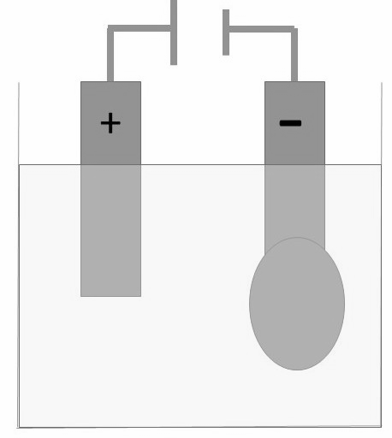
Solution would need to contain silver ions/Ag⁺
The spoon would need to be negatively charged
Spoon as cathode
Solution containing silver ions
Source Mr Campbell

