Slide 1
Unit 6: Fractions and Decimals
Fractions and Decimals
Independent Task
Mathematics
Lesson 6 of 15
Mr Whitehead

Slide 2
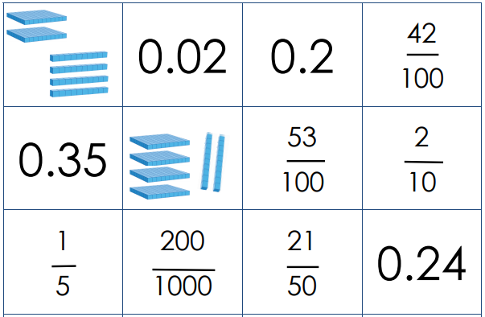
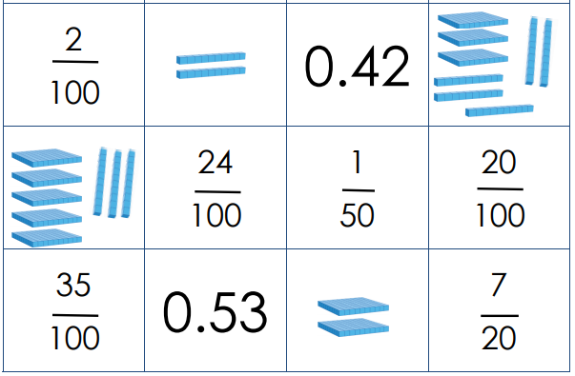
Match the different representations of fractions and decimals and explain your choice

