Slide 1
Number Pyramids Worksheet
Mathematics
Mr Coward

Slide 2
Try this
The numbers on the bottom row are multiplied to fill the middle row.
The numbers in the middle row are added to fill the top brick.
28
8
20
2
4
5
7
2
6
60
25
60
9
4
10
5
5
Copy and complete the pyramids.
How many solutions can you find for the final pyramid?
Notes:
Copy and complete the pyramids.
How many solutions can you find for the final pyramid?

Slide 3
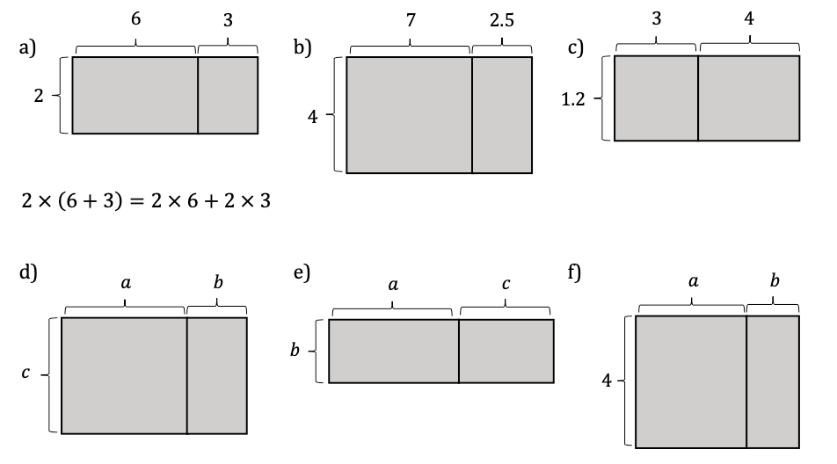
Independent task
For each diagram write out two equivalent expressions.

Slide 4
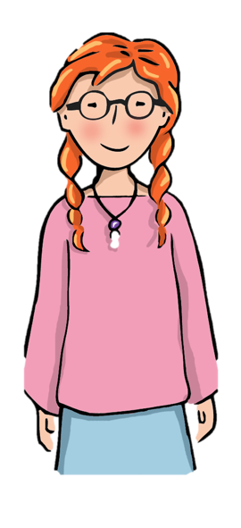
Explore
We can see that Yasmin’s conjecture will always be true.
The top brick will be a multiple of the middle brick on the bottom row.
What other conjectures and generalisations can you come up with?
The top brick will be even if…
The top brick will be greatest if…
The top brick will be a square number if…

