Slide 1
Review Lesson
Combined Science - Chemistry - Key Stage 4
Energy Changes
Mrs. Begum

Slide 2
Energy changes
Activation energy: The minimum amount of energy needed to start a reaction.
Combustion: An exothermic reaction in which a fuel is oxidised.
Endothermic reaction: A reaction in which more energy is required to break bonds than is released when bonds are made.
Evaluate: Give the advantages and disadvantages of something. If given data or information to use, explain why this is an advantage.
Exothermic reaction: A reaction in which more energy is released when bonds are made than is required to break bonds in the reactants.
Insulator: A material that does not conduct heat well so will reduce energy transfers.
Neutralisation: A type of chemical reaction where acids are neutralised and energy is released.

Slide 3
Independent task 1 - variables
What is an independent variable?
What are control variables?
What is a dependent variable?
What equipment can be used to make sure that heat is not lost to the surrounding?
Why do we do repeats?

Slide 4
Independent task 1 - variables - answers
What is an independent variable? The variable that you change
What are control variables? The variables that you keep the same
What is a dependent variable? The variable that you measure
What equipment can be used to make sure that heat is not lost to the surrounding? Polystyrene cup or insulation around a beaker or a lid
Why do we do repeats? To identify anomalies and calculate the mean

Slide 5
Independent task 2
Is bond making endothermic or exothermic?
Is bond breaking endothermic or exothermic?
What is activation energy?
Why is a reaction overall exothermic?
Why is a reaction overall endothermic?

Slide 6
Independent task 2 answers
Is bond making endothermic or exothermic? Exothermic
Is bond breaking endothermic or exothermic? Endothermic
What is activation energy? The minimum energy needed to start a reaction
Why is a reaction overall exothermic? More energy has been released during bond making than has been used for bond breaking
Why is a reaction overall endothermic? More energy has been used during bond breaking than has been released during bond making

Slide 7
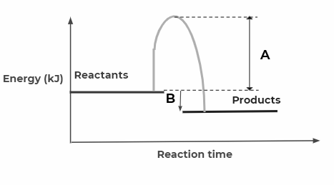
Exam style question 1
Questions
What do letters A and B represent?
What type of reaction is it? Explain how you know by the reaction profile.
Explain what is happening in terms of bond breaking and bond making.
Figure 1 shows the reaction profile diagram for the reaction between hydrogen and fluorine.

Slide 8
Exam style question 1 answers
Questions
What do letters A and B represent? A = activation energy; B = overall energy change
What type of reaction is it? Explain how you know by the reaction profile. Exothermic. The products have less energy than the reactants and the overall energy change is negative.
Explain what is happening in terms of bond breaking and bond making. More energy has been released during bond making than has been used for bond breaking.
Figure 1 shows the reaction profile diagram for the reaction between hydrogen and fluorine.

Slide 9
Exam style question
The equation for the reaction of ethene and chlorine is:
C₂H₄ + Cl₂ C₂H₄Br₂
The reaction is exothermic.
The reaction can be represented as:
C=C + Cl-Cl Cl C–C Cl
Bond | Energy (kJ/mol)
C–C | 348
C=C | 614
C–H | 413
C–Cl | 328
Cl–Cl | 242
H
H
H
H
H
H
H
H
Question
Use the bond energy values in the table to show that the overall energy change is −148 kJ/mol.

Slide 10
Exam style question 2 answers
Bond | Energy (kJ/mol)
C–C | 348
C=C | 614
C–H | 413
C–Cl | 328
Cl–Cl | 242
H
H
H
H
C=C + Cl-Cl Cl C–C Cl
H
H
H
H
Bonds broken
614 + (4 x413) + 242
= 2508 kJ/mol
Bonds made
342 + (4 x 413) + ( 2 x 328)
= 2656 kJ/mol
Question
Use the bond energy values in the table to show that the overall energy change is −148 kJ/mol.
Overall energy =2508 − 2656
Overall = −148 kJ

