Slide 1
Writing instructions:
Making a sock puppet
Communication and Language: Clothes and Fashion – Applying Learning
Alison

Slide 2
For this lesson, you will need:
paper
pen or pencil
ruler
symbols / words from lesson 3

Slide 3
Writing instructions
In this lesson we are going to go through the steps to write the instructions for making a sock puppet.
You might find it useful to watch the video lesson on using writing frames in Unit 4 Lesson 2.
Images from Pixabay.com

Slide 4
The writing frame
Title
First draw or print out the writing frame to help us to layout the instructions.
By using a writing frame the child can see how to arrange their writing on the page.
You can use words or symbols to complete the writing.
What we will need
Instructions:
1.
2.
3.
4.
5.
6.

Slide 5
Now it’s time to complete the activity
Make a writing frame
Use a ruler to draw your own writing frame on paper.
An adult can help you.

Slide 6
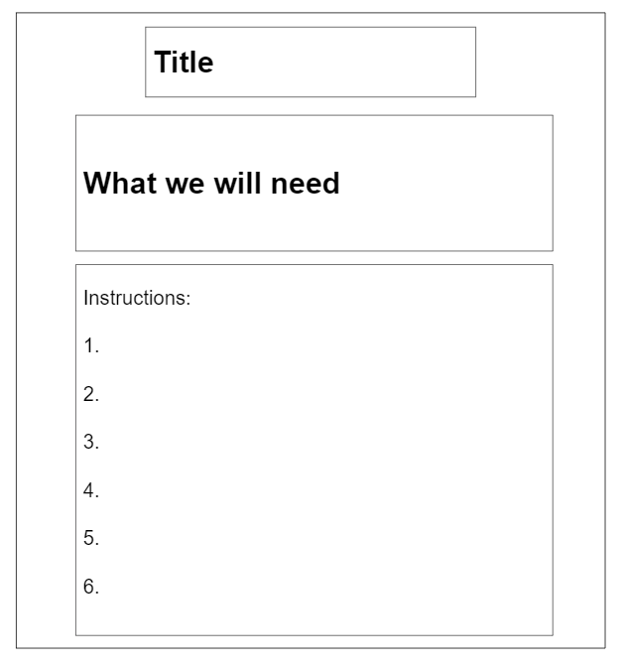
The title
How to make a sock puppet.

Slide 7
Now it’s time to complete the activity
Write the title
Use the symbols or word to help you write your title.
You can write a long title: how to make a sock puppet.
Or you can write a short title: sock puppet.

Slide 8
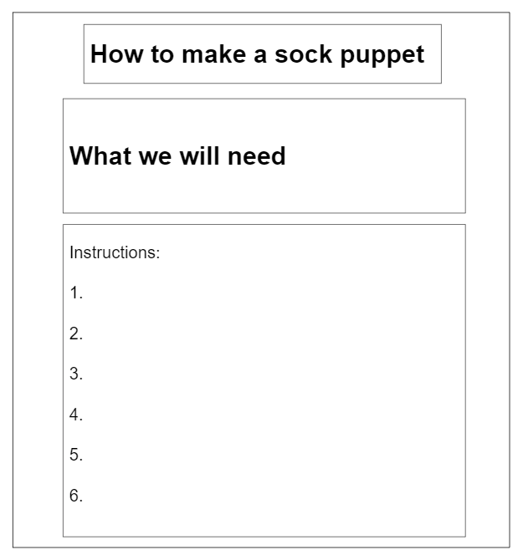
Adding your equipment
Write down all the things you will need in the next box on the writing frame.

Slide 9
Now it’s time to complete the activity
What you will need
In the next box on your writing frame add all of the things you will need to make the sock puppet.
These can be written in a list.
You can use symbols to help you with your writing.

Slide 10
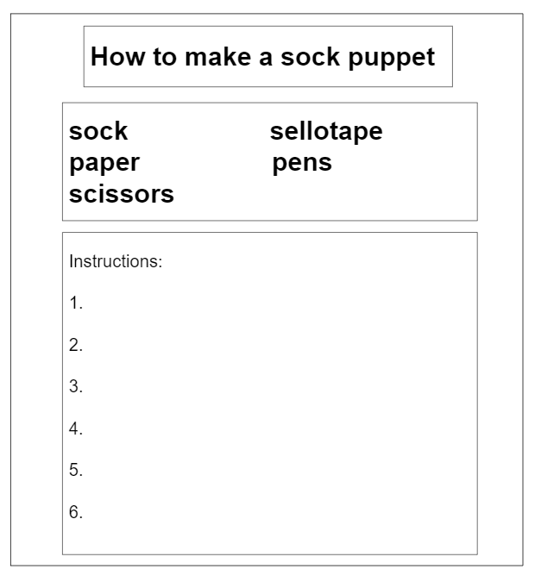
Writing the instructions
Next we will write the instructions.
Before doing this you might want to write down or cut out all of the steps. With your child, have a go at sequencing them in order.
You can then use these as a guide to complete your instructions.
On the next slide are all of the steps.

Slide 11
What do we do first?

Slide 12
Now it’s time to complete the activity
Writing the instructions
Cut out or write down the separate steps to make a sock puppet.
Sequence these in order.
Use the sentence strips to help you write your instructions on the writing frame.

Slide 13
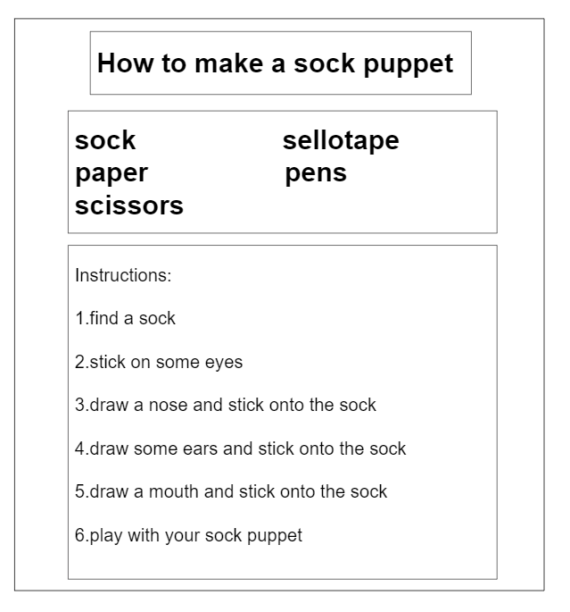
Your finished instructions
Your finished instructions will look a bit like this.

Slide 14
Make it easier
Make it harder
More ideas
Use printed or pre-written symbols or words to stick onto your writing frame.
Reduce the adult support.
Reduce the amount of support given when writing.
Your could try sounding out each word as you write it.
Write instructions for different types of puppets.

