Slide 1
Talking about volunteering [3 / 3]
Using direct object pronouns
French
Madame Williams
Madame Williams

Slide 2
[ an / en ]
enfant

Slide 3
faire du bénévolat | To volunteer
travailler | To work
aider | To help
donner de confiance | To give confidence
développer de nouvelles compétences | To develop new skills
participer à la vie en société | To participate in society
rencontrer de nouvelles personnes | To meet new people
les sans-abri / les SDF | homeless people
les enfants | children
enrichissant | rewarding
The infinitive can also be translated by the gerund.
Travailler = to work AND working

Slide 4
There are three direct object pronouns in French: le, la, and les.
Je déteste le chocolat
Je déteste les bonbons
Je le déteste
Je les déteste
Je déteste la tarte au citron
When the verb starts with a vowel or silent [h], le and la become l’
Je la déteste
The direct object pronoun is placed between the subject of the sentence (in this case the word for I) and the verb

Slide 5
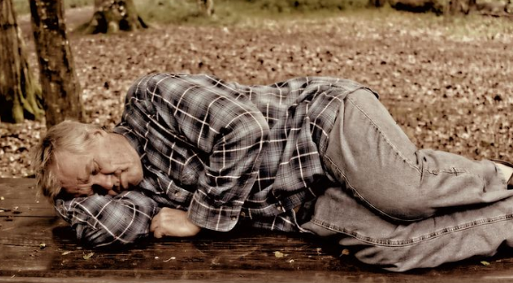
Replacing ideas or concepts - infinitive phrases
J’aime travailler avec les SDF
J’aime travailler avec les SDF
Je l’aime
Je le trouve enrichissant
= I like it
= I find it rewarding
This can add complexity to our work and help to avoid repetition.

Slide 6
Volunteering (3/3)
1. Direct object pronouns replace …………. in a sentence.
2. Masculine nouns are replaced by…...
3. Feminine nouns are replaced by …..
4. Plural nouns are replaced by …….
5. Infinitive phrases can also be replaced by the object pronoun…..
6. Object pronouns are generally positioned between the …. and the ………
nouns
le
la
les
le
Pronoun and the verb

