Slide 1
Reading distance on a map
Downloadable Resource
Geography
Mr D May

Slide 2
Task 1 - Complete these written tasks
A. What does scale mean?
B. What is a common phrase used for straight line distances?
Hint: Try to use an example to help your answer (e.g. OS Explorer maps are 1 : 25 000)
Hint: There are two, and both are to do with animals
C. In your own words, explain how you could measure real life distances using a piece of string, a ruler and the scale line.
Hint: It might be helpful to write this as step-by-step instructions

Slide 3
Task 2 - Complete these conversions
Use the help box to guide your calculations. You may use a calculator.
On a 1 : 25 000 scale map what would the following measurements be in kms?
A. 4 cm
B. 12 cm
C. 6.5 cm
D. 2.7 cm
E. 9.2 cm
Step 1 Multiply distance by scale __ x __ = | __cm
Step 2 Convert to metres _____ ÷ 100 = | __m
Step 3 Convert to km ___ ÷ 1,000 = | __km
___cm = ___km

Slide 4
Task 3 - Complete these tasks using the OS Map on the next slide
A. Roughly how far is it from the telephone box in 9000 (west of Watton) to the telephone box in 9300 (east of Watton)?
(in km)
B. Roughly how far is it from the pub in 9400 to the pub in 9499?
(in km)
C. In metres, roughly how long is Wayland Wood? Measuring from the northern point to the southern point?
D. What is the six-figure grid reference for the nature reserve symbol in Wayland wood? (The blue bird)
Option 3
Option 4

Slide 5
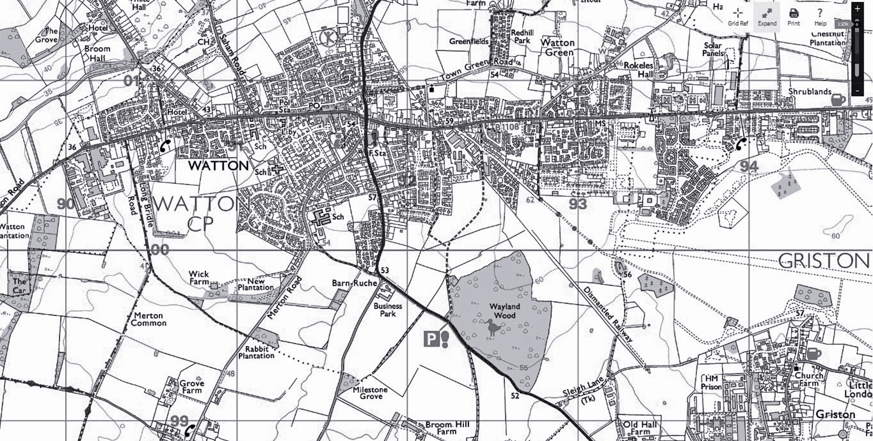
OS Map extract - 1 : 25 000 (1 grid square = 1 km)

