Slide 1
Finding the Surface Area of Cubes and Cuboids
Maths
Miss Davies

Slide 2
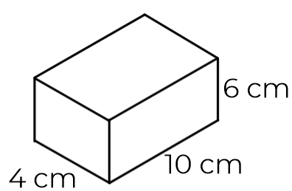
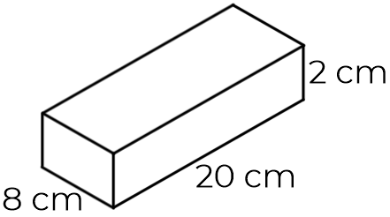
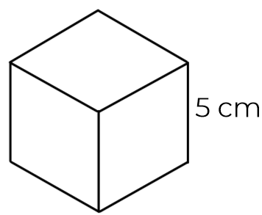
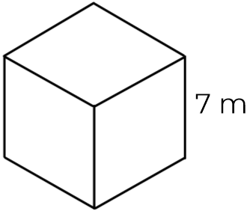
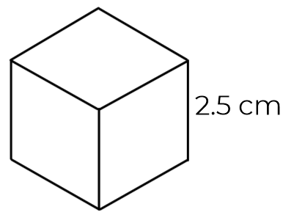
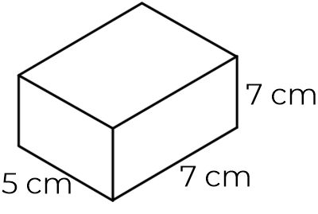
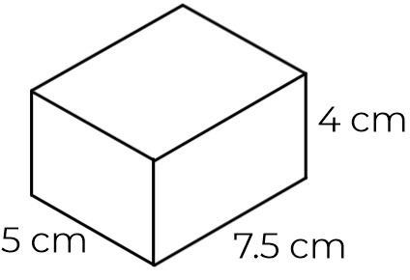
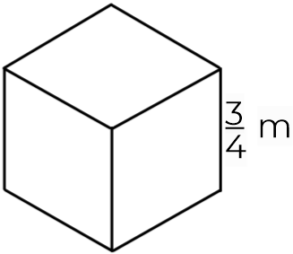
Finding the Surface Area of Cubes and Cuboids
1. Calculate the surface area of the cubes.
a) b)
c) d)
2. Calculate the surface area of the cuboids.
a) b)
c) d)
6 cm
2 cm
5 cm
7 m
4 cm
10 cm
8 cm
20 cm
7 cm
4 cm
2.5 cm
5 cm
7 cm
5 cm
7.5 cm

Slide 3
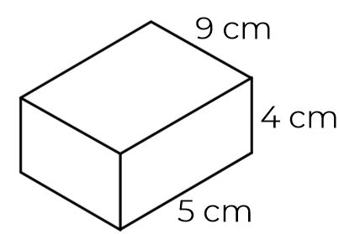
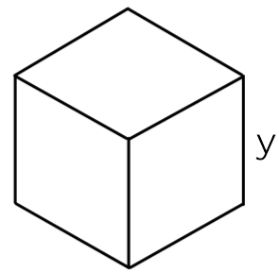
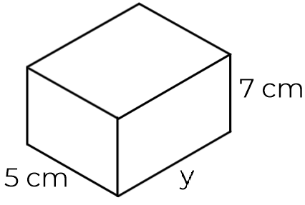
Finding the Surface Area of Cubes and Cuboids
3. Michaela is working out the surface area of the cuboid.
What mistake has she made?
4. A cube has volume of 512 cm³.
What is the surface area of the cube?
5. By finding the missing lengths, calculate the volume given the surface area.
a) S.A. = 726 cm² b) S.A. = 166 cm²
9 cm
4 cm
5 cm
y cm
7 cm
5 cm
y cm

Slide 4
Answers

Slide 5
Finding the Surface Area of Cubes and Cuboids
1. Calculate the surface area of the cubes.
a) 150 cm² b) 294 m²
c) 37.5 cm² d) 3.375 m²
2. Calculate the surface area of the cuboids.
a) 248 cm² b) 432 cm²
c) 238 cm² d) 175 cm²
6 cm
2 cm
5 cm
7 m
4 cm
10 cm
8 cm
20 cm
7 cm
4 cm
2.5 cm
5 cm
7 cm
5 cm
7.5 cm

Slide 6
Finding the Surface Area of Cubes and Cuboids
3. Michaela is working out the surface area of the cuboid.
What mistake has she made?
She needs to multiply it by 2, as there are two of each face.
4. A cube has volume of 512 cm³.
What is the surface area of the cube?
384 cm²
5. By finding the missing lengths, calculate the volume given the surface area.
a) S.A. = 726 cm² b) S.A. = 166 cm²
Volume = 1331 cm³ Volume = 140 cm³
9 cm
4 cm
5 cm
y cm
7 cm
5 cm
y cm

