Slide 1
Plants and Photosynthesis
Lesson 10- Plants as food
Biology - Key Stage 3
Miss White

Slide 2
Name the 4 uses of glucose
1.
2.
3.
4.

Slide 3
Task
What is the name for the organism at the start of the food chain?
What is transferred up the food chain?
Name 2 uses of glucose
Describe how you would test for starch - Include the chemical used and the relevant colour changes

Slide 4
Prediction
Fill in your table with your prediction
Food | Colour change of iodine
Potato
Carrots
Biscuit
Pasta

Slide 5
Independent Task
Food | Colour change of iodine
Potato | Brown to black
Carrots | Stayed brown
Biscuit | Brown to black
Pasta | Brown to black
1.Describe what the results tell about the content of our staple foods.
2.Support your description with results from the starch test using iodine.
3.Explain why we see this result.
Keywords
iodine, glucose, photosynthesis, plants, starch,

Slide 6
Quick check
Why are plants known as producers?
Name two other food sources sugars can be used to produce
Why are humans classed as omnivores?

Slide 7
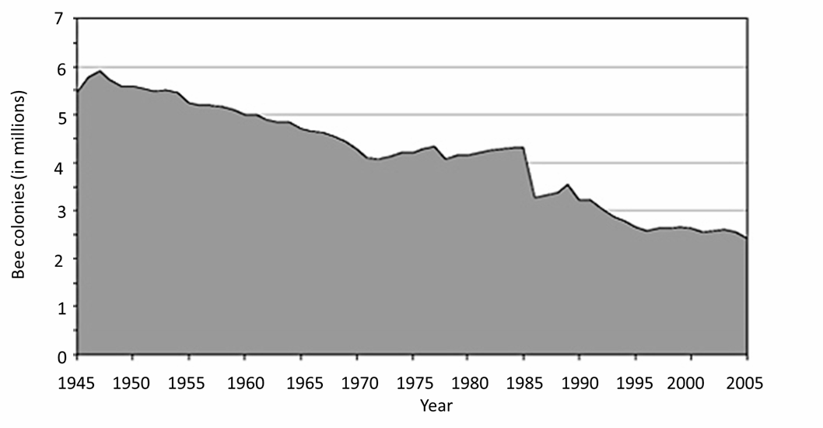
Bee populations
This graph shows the bee population between 1945 and 2005
Describe the pattern shown in the graph
Source: Miss White

Slide 8
Task:
Describe the role of plants in providing these conditions -Use the photosynthesis equation to help you
Condition for animal life | How plants contribute to this
Low levels of carbon dioxide
Oxygen needed for respiration
Availability of food

