Slide 1
Planning an Investigation to find Rate of Reaction
Worksheet
Combined Science - Chemistry - Key Stage 4
The Rate and Extent of Chemical Change
Dr Deng

Slide 2
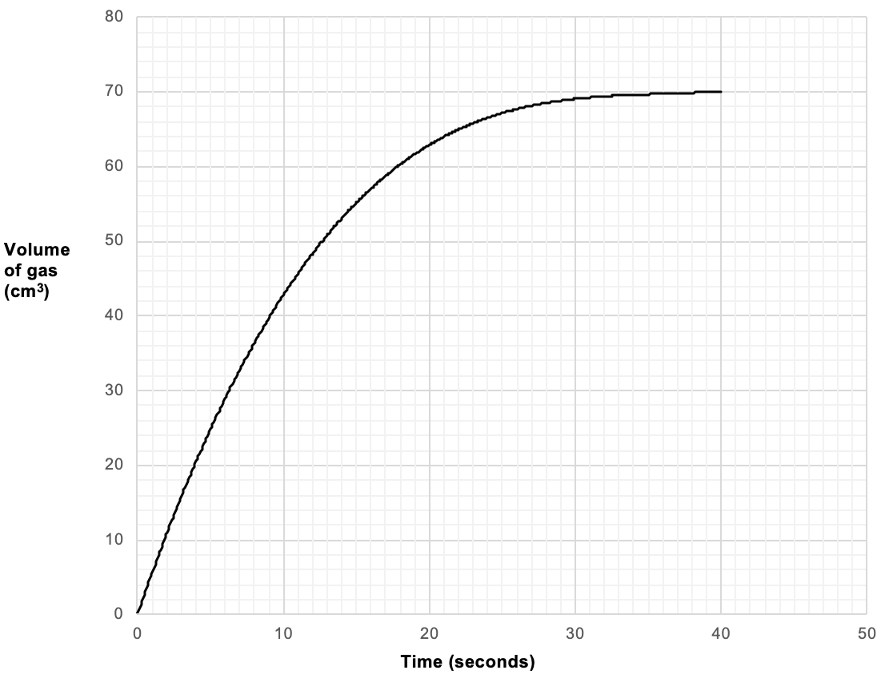
Independent practice
A student investigated the reaction between magnesium and hydrochloric acid to produce magnesium chloride salt and hydrogen gas.
The graph shows the results plotted by the student.
Describe and Explain what is happening to rate of reaction:
In the first 10 seconds
Between 15 and 25 seconds
Between 35 and 40 seconds
Rate of reaction graph, E Deng

Slide 3
Independent practice answer
Describe and Explain what is happening to rate of reaction:
In the first 10 seconds
Describe: Rate of reaction increased quickly as the gradient of the graph is very steep. The volume of gas produced increased from 0 to 42 cm³.
Explain: Reaction took place quickly as more reacting magnesium is present in the conical flask with hydrochloric acid, therefore particles collide more frequently.
Rate of reaction graph, E Deng

Slide 4
Independent practice answer
Describe and Explain what is happening to rate of reaction:
Between 15 and 25 seconds
Describe: Rate of reaction started to slow down as the gradient of the graph became less steep. The volume of gas produced increased from 54 to 67 cm³.
Explain: The reaction started to slow down as little magnesium is left in the conical flask reacting with with hydrochloric acid, therefore particles collide less frequently.
Rate of reaction graph, E Deng

Slide 5
Independent practice answer
Describe and Explain what is happening to rate of reaction:
Between 35 and 40 seconds
Describe: Reaction has stopped as the graph flattens. No gas has been produced.
Explain: Reaction has stopped because all the magnesium has reacted with hydrochloric acid. No hydrogen gas is released.
Rate of reaction graph, E Deng

