Slide 1
3-D Shape: Problem solving using 2-D representations of 3-D shapes
Mathematics
Ms Jeremy

Slide 2
3-D shape vocabulary
Face
Edge
Vertex
Vertices
Apex
A corner where edges meet.
A flat or curved surface on a 3-D shape.
Corners where edges meet.
The area where 2 faces meet.
The vertex at the top of the shape.

Slide 3
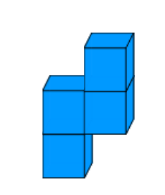
Pause the video to complete your task
Resume once you’re finished
Can this shape be represented using a 2-D format?

Slide 4
Introducing the problem
Dear pupils, We wondered whether you could design us some homes. Each home should be made out of 4 cubes and we would like 12 different homes designed.
Many thanks,
Nevile, Lucy, Simon & Flo

Slide 5
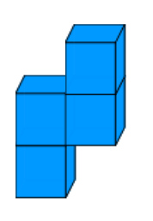
Introducing the problem
For every 1 square of land used, there will be a cost of £36.
For every cube face exposed, the paint will cost £7.
Squares of land used and total cost
Cube faces exposed and total cost
Total cost

Slide 6
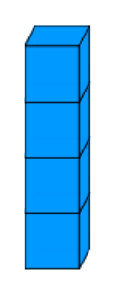
Pause the video to complete your task
Resume once you’re finished
Solving the problem
Squares of land used and total cost
Cube faces exposed and total cost
Total cost

Slide 7
Independent Task
Pause the video to complete your task
Create 10 further birdhouse designs and identify the total cost.
Which design is cheapest?
Which design is most expensive?
Resume once you’re finished
Squares of land used and total cost
Cube faces exposed and total cost
Total cost

