Slide 1
Talk about your daily routine [4 / 4]
Devoir/pouvoir + reflexive verbs
French
Mademoiselle Martin

Slide 2
Phonétique

Slide 3
[SFC]
c r f l
Be c a r e f u l with these!

Slide 4
[SFC]
dans
X

Slide 5
[SFC]
petit
grand
mot

Slide 6
[ é ]
[-er]
[-et]
écrire

Slide 7
[ é / er / et ]
bébé
aller
et
[and]

Slide 8
Grammaire Devoir/pouvoir + reflexive verbs

Slide 9
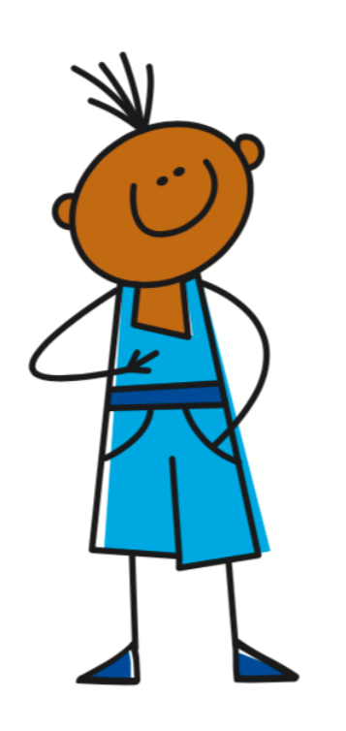
Reflexive -er verbs
Je me lève
= I get up
se lever
= to raise oneself
= to get up
The first person (pronoun + reflexive pronoun + ending)
Remember that se becomes me to match the subject of the sentence - je

Slide 10
Devoir
- to have to / must
Pouvoir
- to be able to
Je dois
= I must, have to
Je peux
= I can
To refer to what you must do
To refer to what you can do

Slide 11
Devoir and pouvoir + infinitive
Use devoir with an infinitive to say what you must do.
Use pouvoir with an infinitive to say what you can do.
Je dois rester chez moi.
Je peux faire la grasse matinée.
I must stay at home.
I can have a lie in.

Slide 12
Je dois + reflexive verb
Je dois
+
se lever
Je dois me lever
= I must/have to get up
= I must
+
= to get up
modal verb + infinitive
Remember that se becomes me to match the subject of the sentence - je

Slide 13
Je peux + reflexive
Je peux
+
se reposer
Je peux me reposer
= I can relax
+
= I can
= to relax
modal verb + infinitive
Remember that se becomes me to match the subject of the sentence - je

Slide 14
Using modal verbs with reflexive verbs
se lever = to get up
se reposer = to relax
Je me lève
= I get up
Je me repose
= I relax
Je dois me lever
= I must/have to get up
Je peux me reposer
= I can relax
If ‘je’ is the subject of the sentence the ‘se’ in the infinitive becomes ‘me’.

Slide 15
Talk about your daily routine [4 /4]
Je dois/peux must be followed by =
I can =
I can get up =
I must =
I must relax =
‘Se’ needs to change to match the
5
4
3
2
the infinitive
1
Je peux
Je peux me lever
Je dois
Je dois me reposer
subject of the sentence

