Slide 1
To count from 1 to 19 and match pictorial and abstract representations of these numbers
Mathematics
Miss Charlton

Slide 2
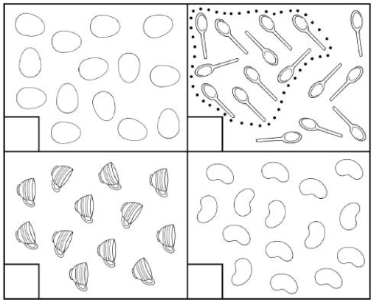
Independent task
16
‹#›

Slide 3
Answers
14
16
12
15
‹#›

