Slide 1
Round up to three significant figures
Maths
Miss Parnham

Slide 2
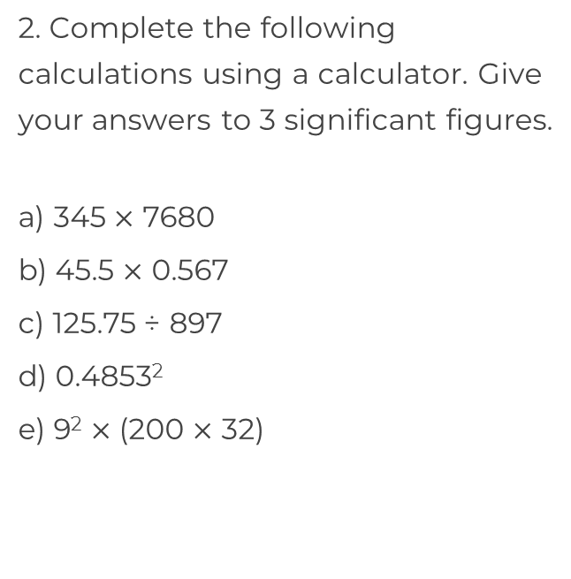
Round up to three significant figures
1. Round the following numbers to 1, 2 and 3 significant figures.
a) 13.425
b) 1.7895
c) 0.4049
d) 0.00593
e) 4.956
f) 0.9999
g) 0.09999

Slide 3
Round up to three significant figures
3. The number of people at a football match, rounded to 3 significant figures, is 52400
a) What is the highest number of people that could have been at the match?
b) What is the fewest number of people that could have been at the match?
4. Calculate the area of the shapes to 3 significant figures.
a)
b)
0.306 cm
0.456 cm
4.305 mm

Slide 4
Answers

Slide 5
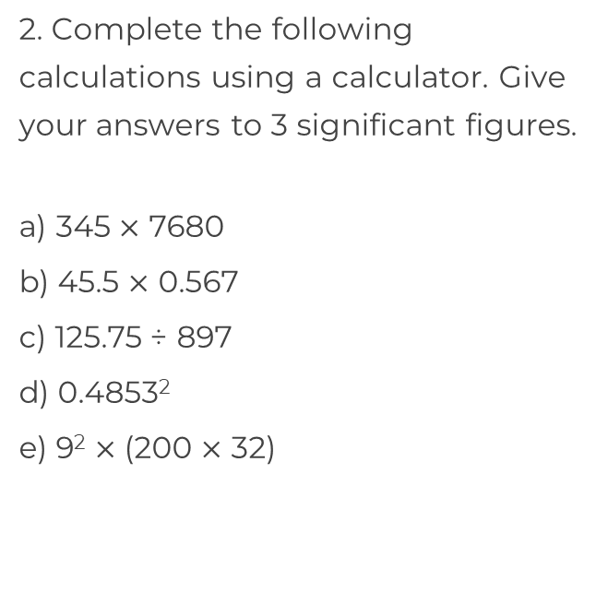
Round up to three significant figures
1. Round the following numbers to 1, 2 and 3 significant figures.
a) 13.425
b) 1.7895
c) 0.4049
d) 0.00593
e) 4.956
f) 0.9999
g) 0.09999
10, 13, 13.4
2, 1.8, 1.79
2,650,000
0.4, 0.40, 0.405
25.8
0.006, 0.0059, 0.00593
0.140
5, 5.0, 4.96
0.236
1, 1.0, 1.00
518,000
0.1, 0.10, 0.100

Slide 6
Round up to three significant figures
3. The number of people at a football match, rounded to 3 significant figures, is 52400
a) What is the highest number of people that could have been at the match?
b) What is the fewest number of people that could have been at the match?
4. Calculate the area of the shapes to 3 significant figures.
a)
b)
0.0698 cm²
0.306 cm
52449 people
0.456 cm
18.5 mm²
4.305 mm
52350 people

