Slide 1
Citizenship
How do identities change?
Lesson 2 of 6
Downloadable Resource
Mrs Barry

Slide 2
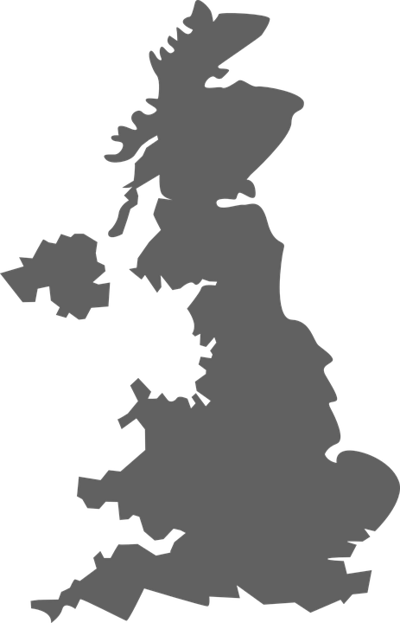
Task Four
England
Northern Ireland
Scotland
Wales
Images via Pixabay

