Slide 1
Number bonds to 10
Mathematics
Independent Task
Miss Robson

Slide 2
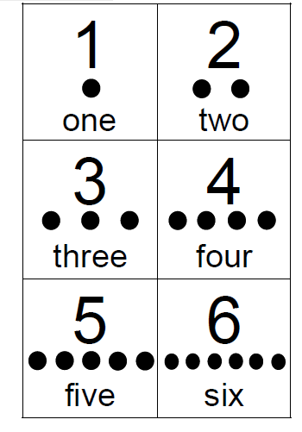
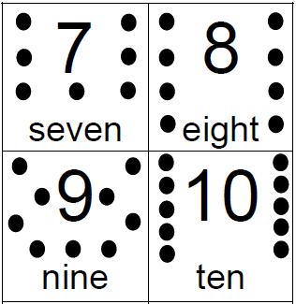
Activity

