Slide 1
Lesson 1 : Keeping strong, fit & healthy
Fitness circuits
Physical Development - Building Understanding
Mark Dolan

Slide 2
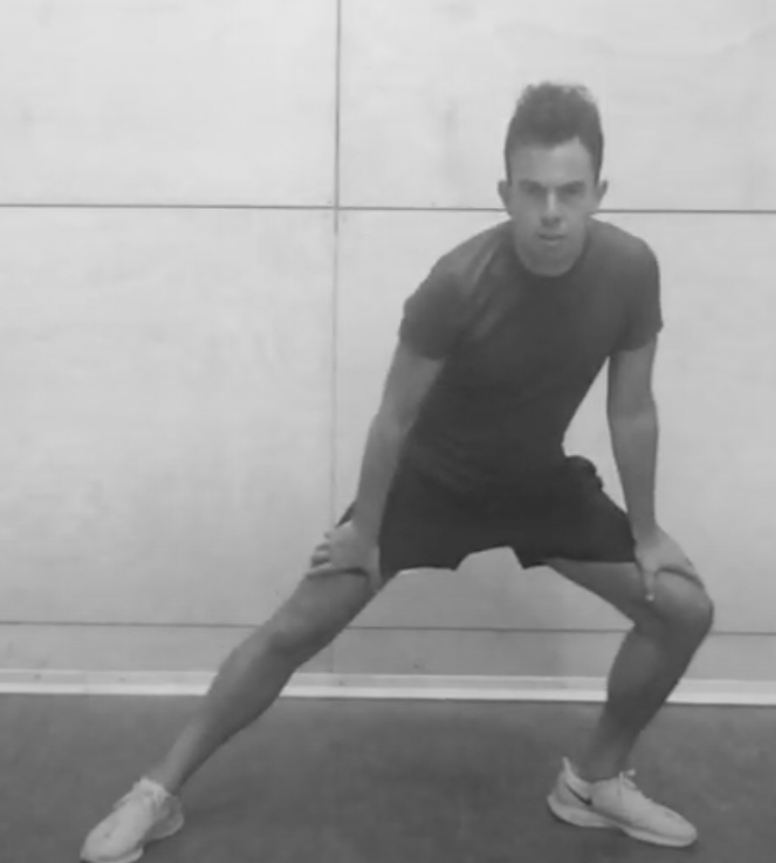
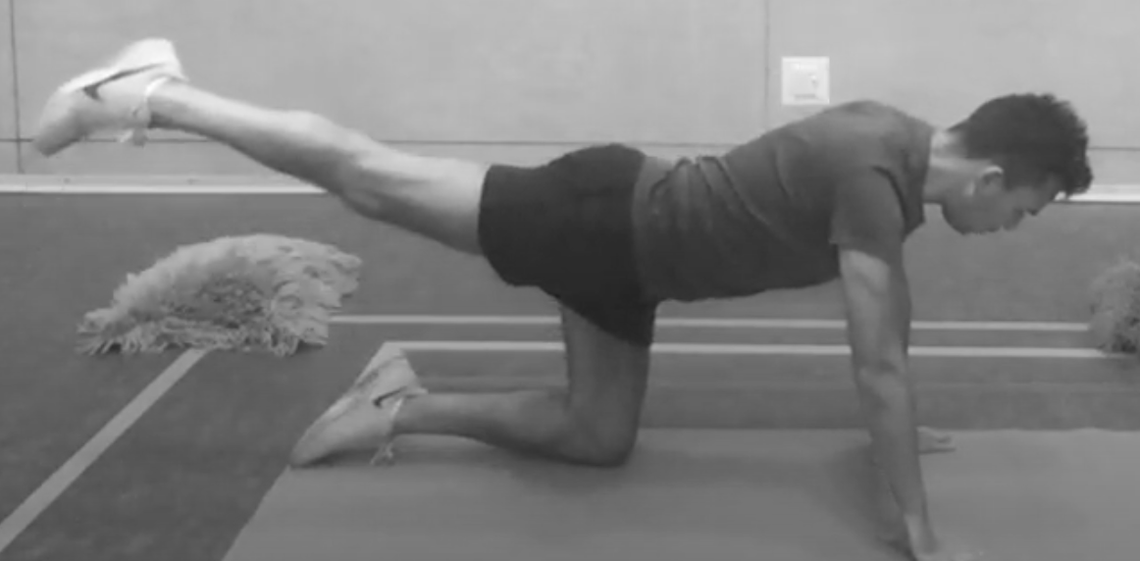
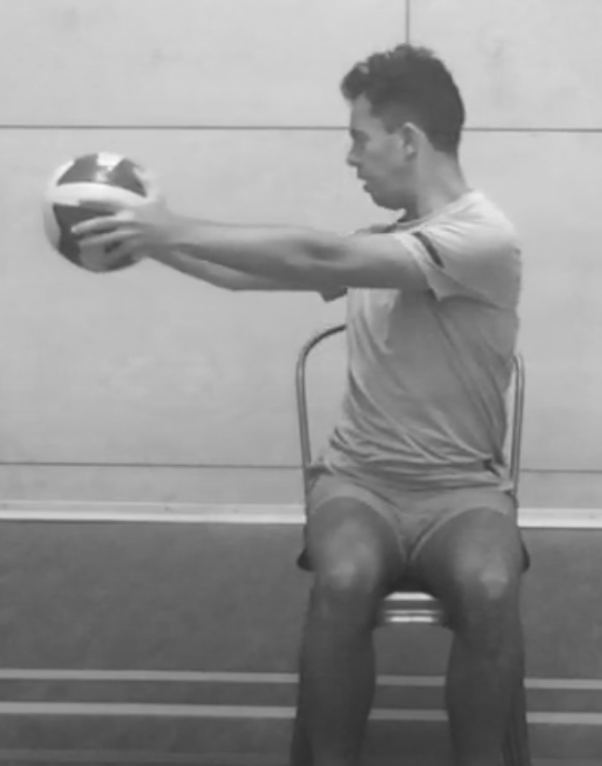
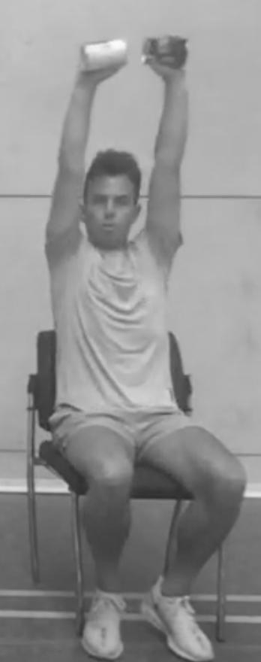
Activity Card
Healthy Living: Fitness circuits
Try different balances as part of your fitness circuit (these could be standing up or sitting down balances).
Practise dynamic movements in your circuit (running, jumping & skipping).
Always make sure you warm up to get your body ready for exercise.
Add stations to your fitness circuit and try to increase the time and intensity of the exercise.
Use household objects as part of your circuit e.g. scarf & tins of soup.
Think about how your body changes before, during and after exercise.
Have some strength stations on your fitness circuit where you can really flex your muscles!
Stretching is really good for us and is an important part of our fitness circuit.

