Slide 1
Talk in the negative (Part 1/2)
Revisit negation in the present tense
Using the verbs savoir and connaître
Downloadable Resource
French
Madame Johnson

Slide 2
Talk in the negative (Part 1/2)
your understanding of the near future tense.
Phonics focus - [r]
Introducing new vocabulary
Grammar focus: Negatives
Grammar practice
Grammar focus: Saying ‘to know’ in French
Reading practice: to know
Listening activity
Speaking
Revisiting vocabulary
Writing: translation practice
Summarising learning

Slide 3
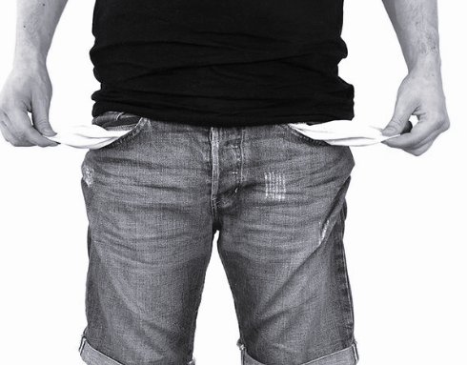
[ r ]
[ rr ]
rien

Slide 4
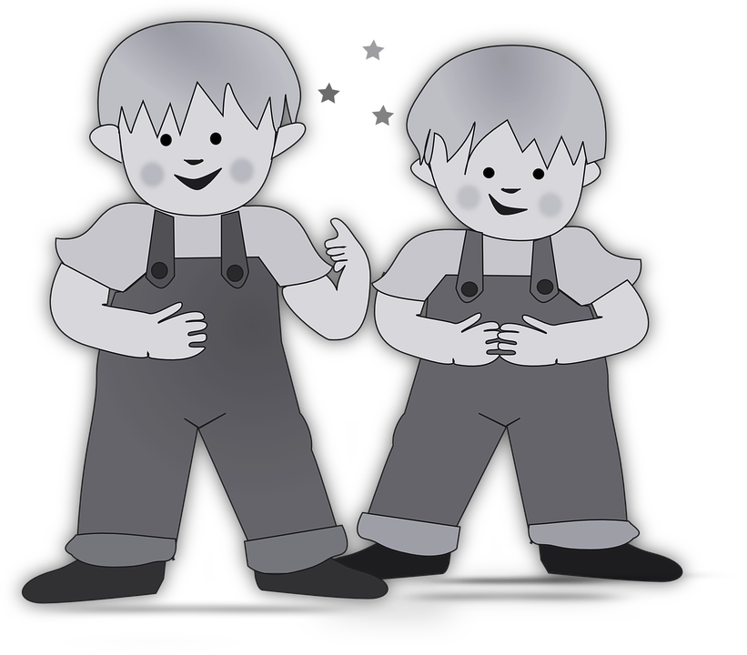
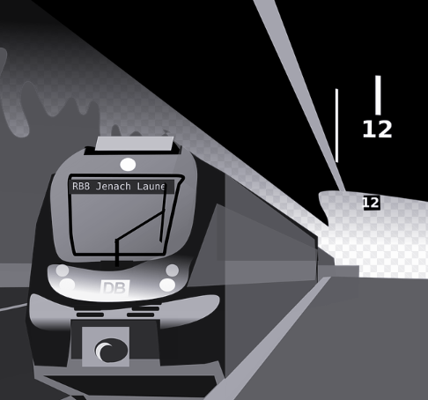
[ r ]
radis
frère
gare

Slide 5
Vocabulary list for this lesson:
oublier | to forget
fumer | to smoke
connaître | to know
je connais | I know
voir | to see
nous voyons | we see
vous voyez | you (pl.) see
ils / elles voient | they see
rien | nothing
jamais | never

Slide 6
Making a sentence negative in English
don’t
I speak
I speak
Add don’t before the verb

Slide 7
Making a sentence negative in French
Je parle
ne
pas
Je parle
Add ne and pas before and after the verb

Slide 8
Making a sentence negative in French
Je écoute
ne
pas
Je écoute
J’écoute
n’
pas
Je écoute
ne changes to n’ before a verb starting with a vowel.

Slide 9
Mets les phrases dans le bon ordre
1.
2.
3.
4.
5.
Je ne connais pas le film
Il ne voit pas la forêt
Ils ne voient pas le pont
Elle ne fume pas
fume
pas
elle
ne
Tu n’oublies pas la date
pas
n’
oublies
tu
la date

Slide 10
Using savoir and connaître
savoir = to know/knowing
connaître = to know/knowing
The verb ‘savoir’ means:
To know how to do something
To know a fact
The verb ‘connaître’ means:
To know (be familiar with) a place, person, thing.

Slide 11
Using savoir and connaître
Je sais parler français.
Je connais Pierre - il est français.
I know how to speak French.
I know Pierre. He is French.

Slide 12
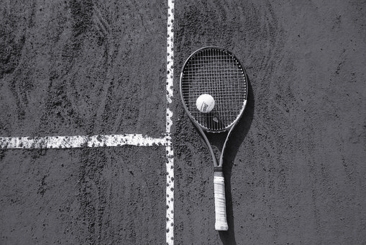
Savoir - to know how to do something
Recommended pre-learning, see lessons: ‘Say what you want to and what you must do’ 1 & 2 (Unit 4, lessons 3 & 4)
Use savoir with an infinitive to say what you know how to do :
Je sais jouer au tennis
Tu sais parler l’anglais?
I know how to play tennis
Do you know how to speak English?

Slide 13
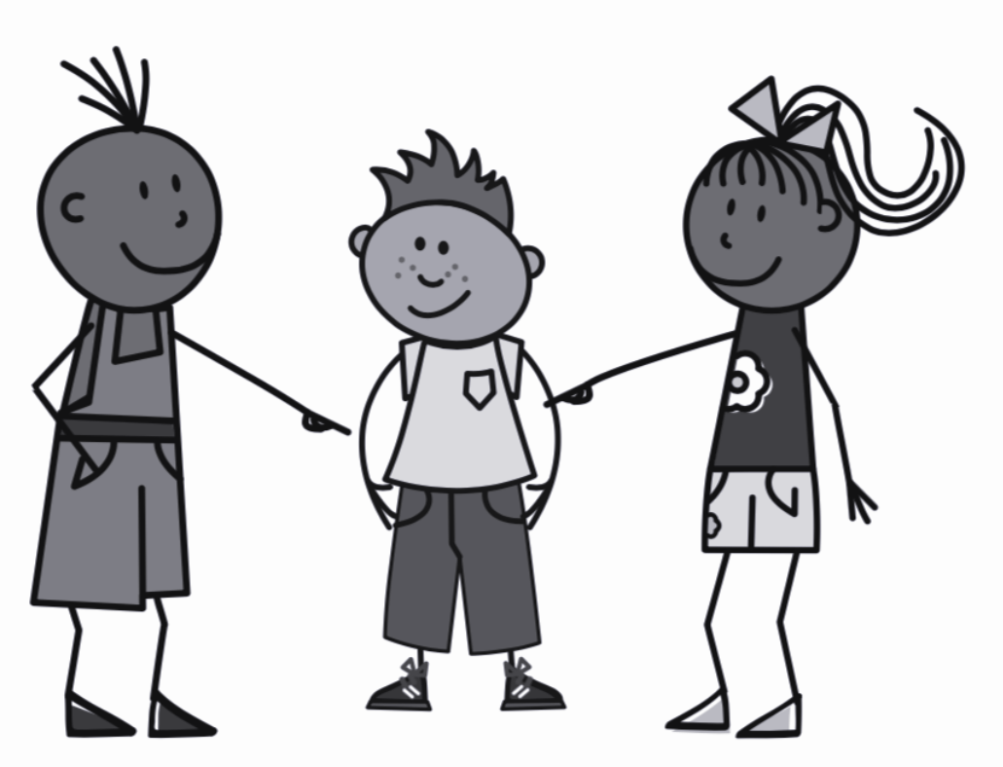
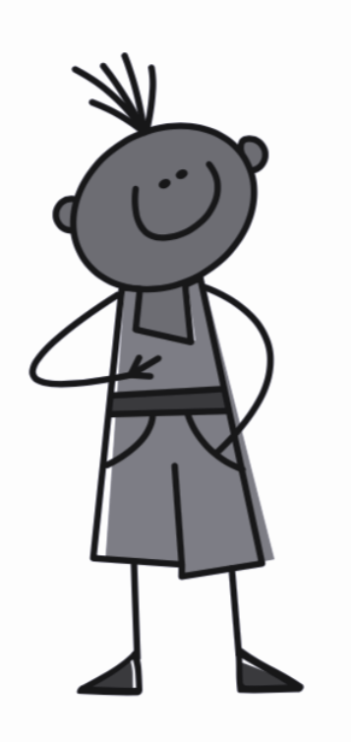
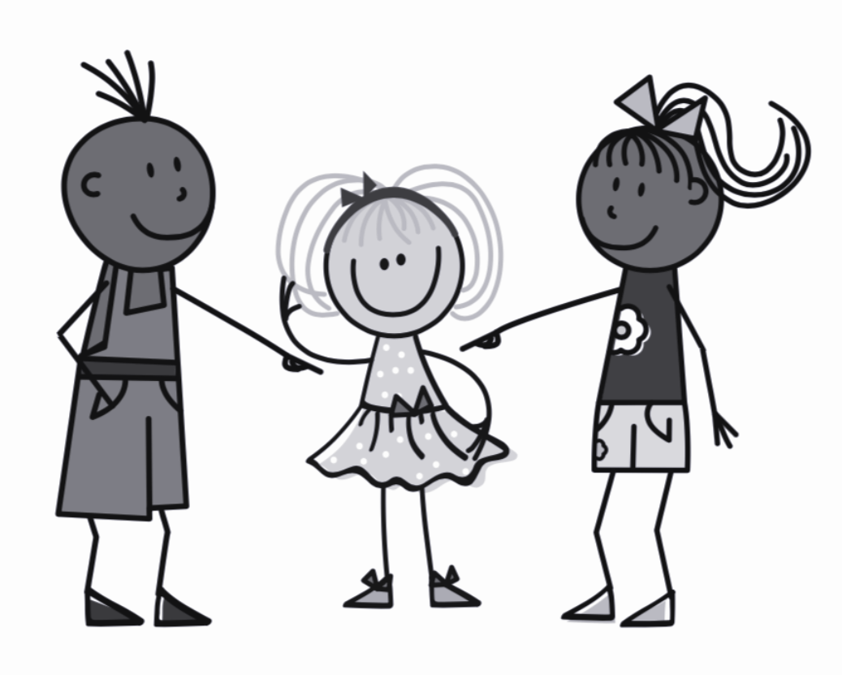
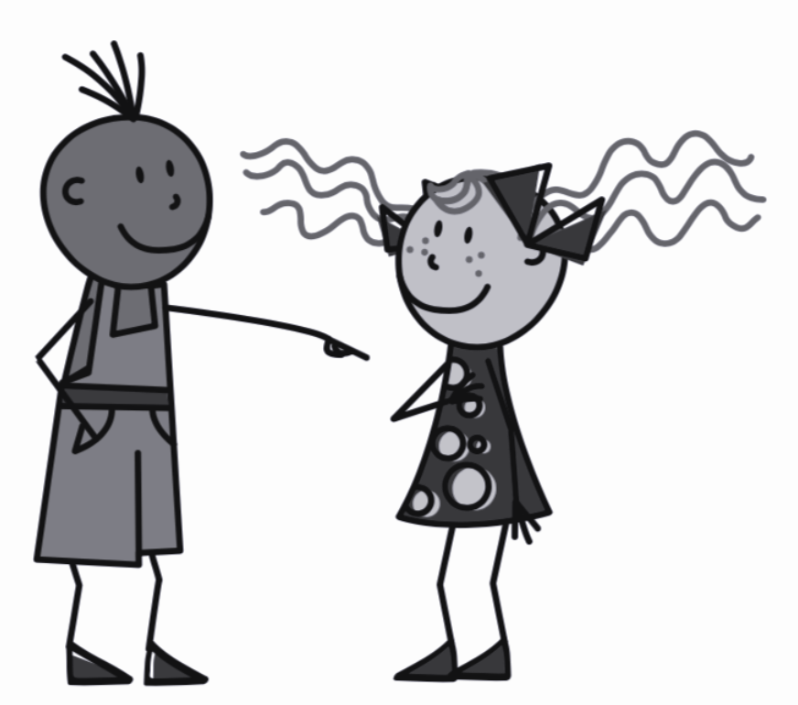
Savoir - to know (how to)
Il sait - He knows
Je sais- I know
Elle sait - She knows
Tu sais - You (specific) know
On sait - You (general) know

Slide 14
Connaître - to know (of/about)
Recommended pre-learning, see lessons: ‘Say what you want to and what you must do’ 1 & 2 (Unit 4, lessons 3 & 4)
Use connaître with what you know of/about or are familiar with:
Je connais Londres
Tu connais mon ami Pierre?
I know London
I’m familiar with London
Do you know my friend Pierre?

Slide 15
Connaître - to know (of/about)
Il connaît - He knows
Je connais- I know
Elle connaît - She knows
Tu connais - You (specific) know
On connaît - You (general) know

Slide 16
Talk in the negative (Part 1/2)
1 | I don’t know how to... =
2 | He doesn’t know London =
3 | We don’t see =
4 | She doesn’t listen =
5 | You (pl.) don’t see the beach =
je ne sais pas
il ne connaît pas Londres
nous ne voyons pas
elle n’écoute pas
vous ne voyez pas la plage

