Slide 1
Shape and Symmetry:
To compare and classify 2-D shapes.
Maths
Mr Critchlow

Slide 2
To Start
How many of the shapes can you name?
A
B
C
D
G
E
F
H
I
J

Slide 3
To Start
How many of the shapes can you name?
Shape | Name | Number of sides | Shape | Name | Number of sides
A |  |  | F
B |  |  | G
C |  |  | H
D |  |  | I
E |  |  | J

Slide 4
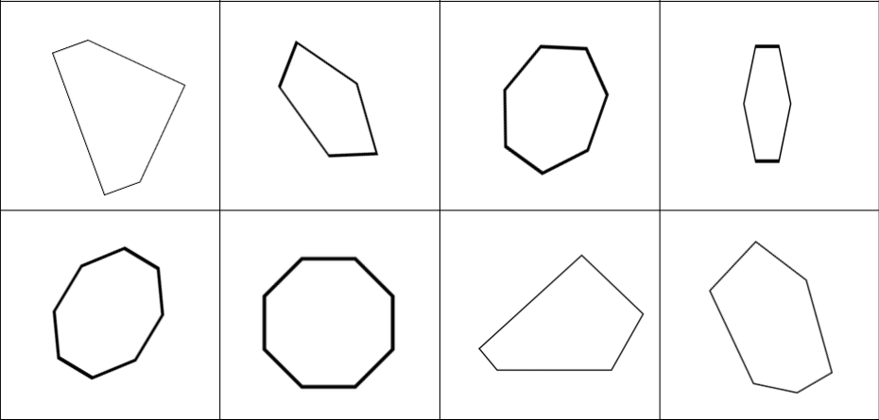
Moving on
Name the regular and irregular shapes below. Write R or I under each. Pick one of each type of shape and explain how you know they are what you say they are. Eg, this shape is regular because_____________. How many vertices does each shape have?

Slide 5
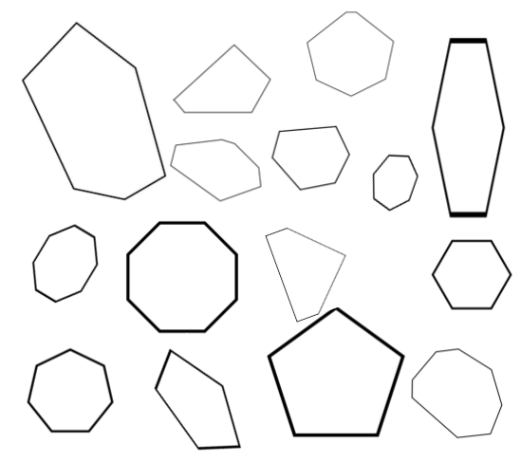
Main Task
Have a partner pick a shape. You must ask questions that have Yes/No answers to try and figure out which shape it is.
c
b
QUESTIONS YOU CAN USE:
Is it a regular shape?
Is it an irregular shape?
Does it have _____ vertices?
Does it have _______ sides?
Does it have parallel lines?
a
d
g
f
e
h
j
i
k
o
m
l
n

