Slide 1
Representing and interpreting data on a block diagram and a table
Mathematics
Miss Mitchell

Slide 2
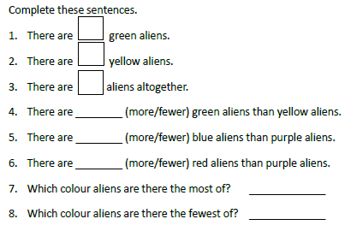
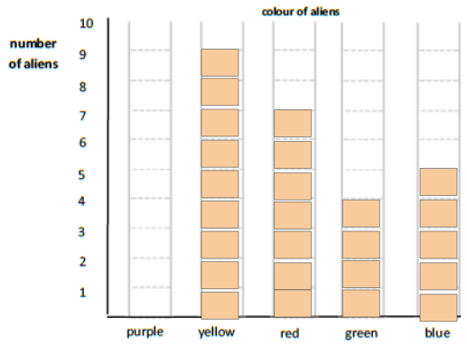
Question 1
Notes:
Why do we use standard units? Why not non standard units?

