Slide 1
Adding and Subtracting Multiples of Ten
Independent Task
Mathematics
Miss Hughes

Slide 2
Example

Slide 3
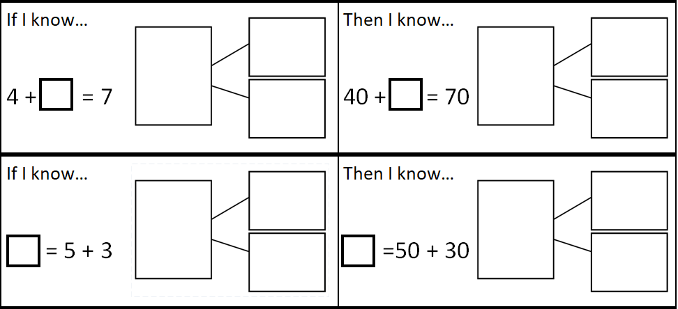
Questions 1 and 2

Slide 4
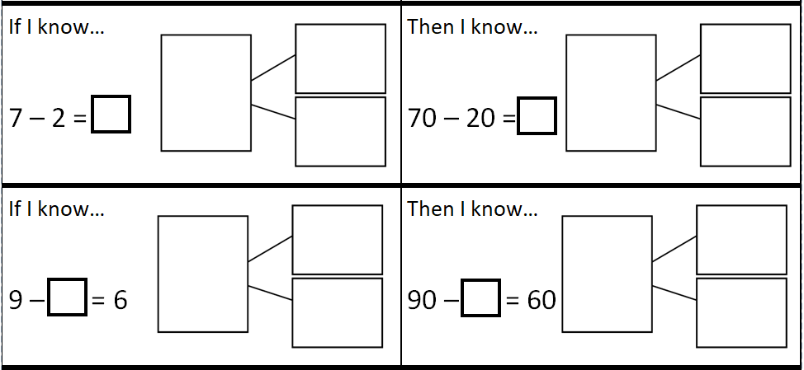
Questions 3 and 4

Slide 5
Question 5

