Slide 1
Applying knowledge of numbers within 1000
Lesson 5 of 5
Mathematics
Miss Jones

Slide 2
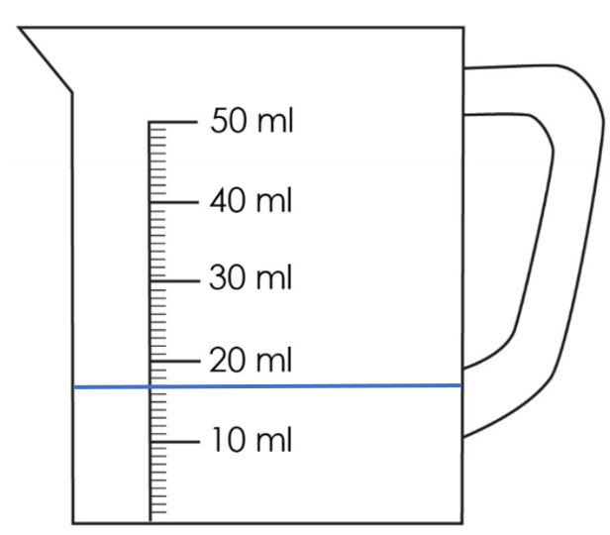
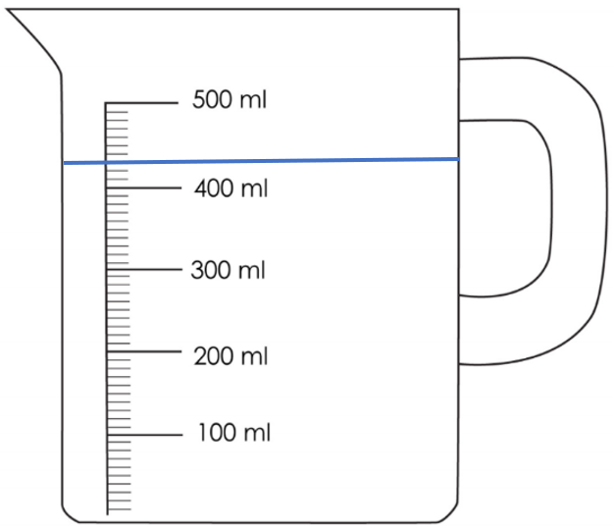
Read the measurements on the scales.
___ cm
___ cm
___ ml
___ ml

