Slide 1
Estimate the area under a curve
Maths
Mr Clasper

Slide 2
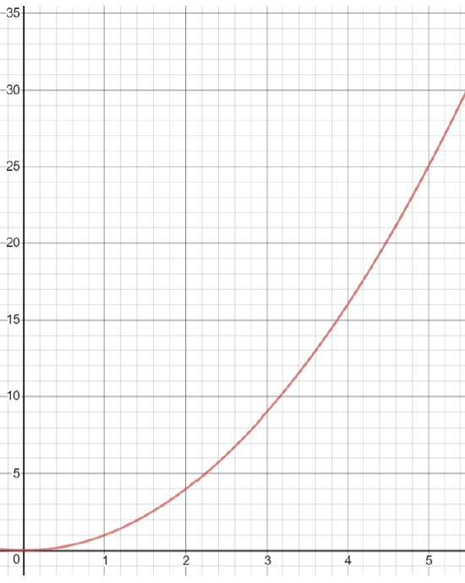
Estimate the area under a curve
1. Here is the graph of y = x²
a) Using 1 strip, estimate the area under the curve between x = 1 and x = 5
b) Using 2 strips, estimate the area under the curve between x = 1 and x = 5
c) Using 3 strips, estimate the area under the curve between x = 1 and x = 5
d) Do you think your answers are over- estimates or under-estimates? Explain your answer.
Image created with desmos.com

Slide 3
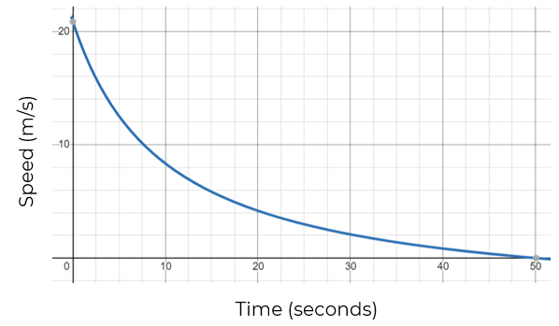
Estimate the area under a curve
2. A train passes through a signal at time t = 0 and starts to slow down.
It comes to stop at a station 50 seconds later.
The graph opposite shows the train’s speed as it approaches the station.
Estimate how far is it between the station and the signal.
Image created with desmos.com

Slide 4
Answers

Slide 5
Estimate the area under a curve
1. Here is the graph of y = x²
a) Using 1 strip, estimate the area under the curve between x = 1 and x = 5
b) Using 2 strips, estimate the area under the curve between x = 1 and x = 5
c) Using 3 strips, estimate the area under the curve between x = 1 and x = 5
d) Do you think your answers are over- estimates or under-estimates? Explain your answer.
52 units²
44 units²
42 units²
Overestimate. The area of the trapeziums are partially above the
curve.
Image created with desmos.com

Slide 6
Estimate the area under a curve
2. A train passes through a signal at time t = 0 and starts to slow down.
It comes to stop at a station 50 seconds later.
The graph opposite shows the train’s speed as it approaches the station.
Estimate how far is it between the station and the signal.
Approximately 265 metres
Image created with desmos.com

