Slide 1
Sketch 3D Shapes When Given a Plan View and Elevation
Maths
Mr Bond

Slide 2
Sketch 3D shapes when given a plan view and elevation
1. Below is the plan view, front elevation and side elevation of a prism.
Sketch the prism.
2. Below is the plan view, front elevation and side elevation of a 3D shape.
Sketch the prism.
Plan
Plan
Side Elevation
Side Elevation
Front Elevation
Front Elevation
‹#›

Slide 3
Answers

Slide 4
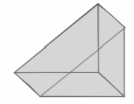
Sketch 3D shapes when given a plan view and elevation
1. Below is the plan view, front elevation and side elevation of a prism.
Sketch the prism.
2. Below is the plan view, front elevation and side elevation of a 3D shape.
Sketch the prism.
Plan
Plan
Side Elevation
Side Elevation
Front Elevation
Front Elevation
‹#›

