Slide 1
Talk about going to places (Part 1/2)
Ordinal numbers
Downloadable Resource
German
Frau Johnson
Notes:
Take the title for the lesson from the context column of the SOL. Take the grammar focus from the grammar column. Show full green screen to start with and then bring in your face in the top right hand corner.
E.g. Hola. Soy [Doctora Hawkes] ¿Cómo estás? In this lesson we [practise the present tense with some regular verbs so we can talk about what people do]. I hope you are in a quiet space without distractions, and have a pen and paper to hand.

Slide 2
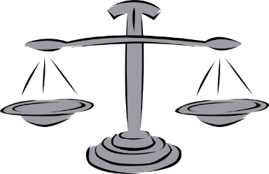
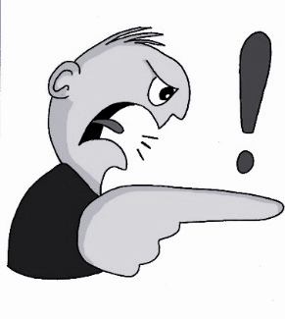
s
Gesetz
Seite
sollen
reisen
Satz
Subjekt
Verb
Objekt
langsam
Ich habe Hunger.

Slide 3
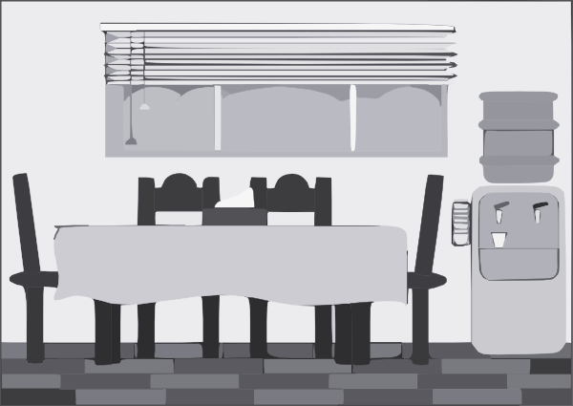
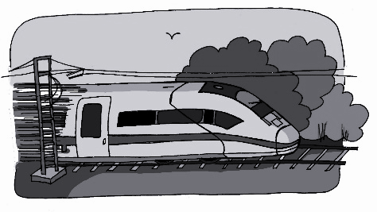
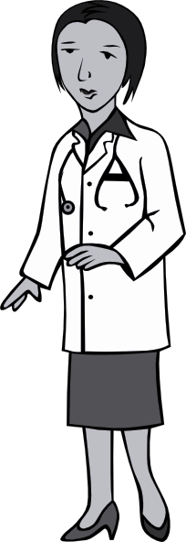
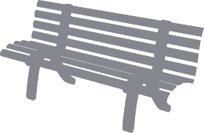
z
Zimmer
zehn
Zug
Arzt
sitzen
Platz

Slide 4
-ig
notwendig
wichtig
[necessary]
[important]
richtig
fertig
wenig
[ready, finished]
Schwierigkeit
[little / not very much]
[difficulty]

Slide 5
Die Nummern 13-19
German numbers 13-19 are simple sums.
drei (3)
+
zehn (10)
=
dreizehn
Some of the numbers lose letters in the teens.
sechs (6)
+
zehn (10)
=
sechzehn
sieben (7)
+
zehn (10)
=
siebzehn

Slide 6
Die Nummern 21-99
When you hear a number between 21 and 99 write it down from right to left as you will always hear the second number first.
Numbers are always written as one word. Some words can be very long. Just break them down to work them out.

Slide 7
Wann ist das?
Just like in English in German you use ordinal numbers to say dates.
You add -te to the numbers 1-19:
Heute ist der vierte Juni.- Today is the 4th of June.
You use ‘der’ because it is ‘der Tag’.
You add -ste to the numbers 20-31:
Heute ist der zwanzigste Juni. - Today is the 20th of June.
You don’t use any word for ‘of’ in German dates.
Notes:
Read information. Last phrase is blue about ‘of’.

Slide 8
Wann ist das?
There are some exceptions to the rules.
der erste- 1st
der dritte- 3rd
der siebte- 7th

Slide 9
Wann ist das?
To say ‘on the’ in German you use the preposition an and the definite article dem.
These two words can be joined together and then they make the word am.
Das Konzert ist am vierten April.
After am you add an ‘n’ to the date.

Slide 10
Talking about going places.
1 The German numbers 13-19 are the small number and the German word _______.
2 When you write the numbers 21 to 99 you should write them from ________ to ______.
3 When creating dates in German you add _____ to the end of the numbers 1-19.
4 You add _____ to the end of the numbers 21-31.
5 To say on the in German you use _____ which is ‘an’ and ‘dem’ joined together.
zehn
right
left
-te
-ste
am
Notes:
Now it’s time to summarise what we have learnt today. You are going to copy down the sentences and fill in the gaps. Stopp das Video. Let’s see how you have done. Click for each answer.

