Slide 1
Discussing what to see and do [1 / 2]
Asking questions
French
Monsieur Lowe

Slide 2
Phonétique

Slide 3
[SFC]
c r f l
Be c a r e f u l with these!

Slide 4
[SFC]
dans
X

Slide 5
[SFC]
petit
grand
mot

Slide 6
[ qu ]
?
question

Slide 7
[ qu ]
quatre
manquer
[to miss, be missing]
musique

Slide 8
ouvert | open
fermé | closed
les heures d’ouverture | opening hours
le prix | price
gratuit | free
la durée | duration
les tarifs | prices
le/la jeune | young person
un(e) étudiant(e) | student
des renseignements | information
un dépliant | leaflet
un billet | ticket

Slide 9
Grammaire Asking questions

Slide 10
Is there a …?
There are two possibilities when asking this question:
Il y a un restaurant? = Is there a restaurant?
Est-ce qu’il y a un magasin? = Is there a shop?

Slide 11
Do you have …?
There are two possibilities when asking this question:
Paris
Vous avez un dépliant? = Do you have a leaflet?
Avez-vous un plan de la ville? = Do you have a map of the town?
Vous - the polite/formal way of saying you.

Slide 12
Grammaire Question words and Time

Slide 13
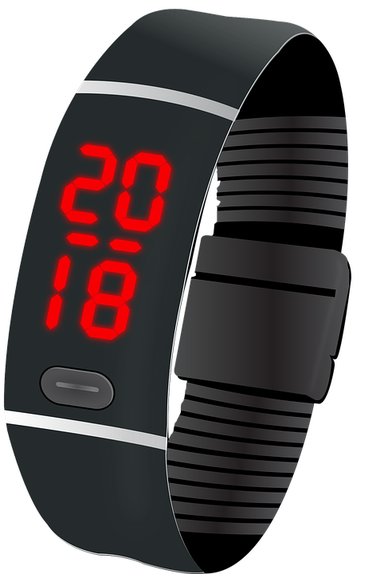
Expressing time
There are two options of expressing time in French:
12 hour
24 hour
Il est dix heures dix = It’s 10 minutes past 10
Il est vingt heures dix-huit = It is 18 minutes past 8

Slide 14
Question words
Here are some question words:
Combien?
Quel?
Où?
Quand?
Qu’est-ce que?
Comment?
C’est combien? - How much is it?
Quel est le prix? - What is the price?
Où sont les toilettes? - Where are the toilets?
Quand commence le match? - When does the match start?
Qu’est-ce qu’on va faire? - When are we going to do?
C’est comment? - What is it like?

Slide 15
Discussing what to see and do
Est-ce que goes
Avez-vous means the same as
The opposite of ouvert is
Who might get a price reduction?
Translate free (of charge) =
Translate C’est combien? =
at the start of a question.
Vous avez
fermé
jeunes/ étudiants
gratuit
How much is it?

