Slide 1
Multiply 2-digit numbers by 6 using the partitioning method
Maths
Miss Brinkworth

Slide 2
Part A - Use partitioning to solve these questions using the 6 times table
45 x 6 =
83 x 6 =
x 6 = 300
6 x = 600
Extension -

Slide 3
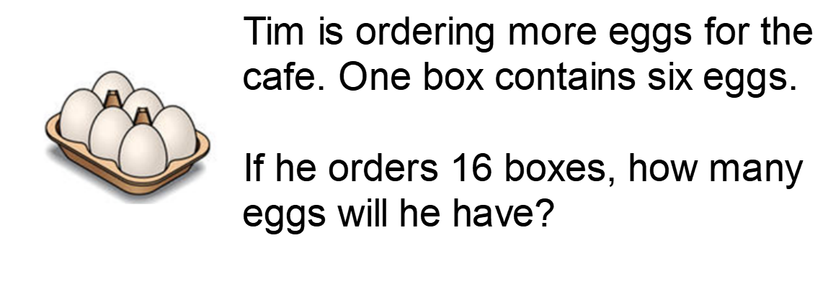
Part B -
Look at the image below, what is the same, what is different?

Slide 4
Part C- Challenge
Billie is on a bug hunt. In her garden there are a mixture of spiders (with 8 legs) and insects (with 6 legs).
The bugs that she finds have a total of 100 legs altogether.
How many spiders and insects did she find?
How do you know?
Is there more than one answer?

