Slide 1
Independent Living Unit 5 - World of Work
Oak Specialist
Applying Learning

Slide 2
Unit 5- World of Work
Lesson 1 - The benefits of work
Lesson 2 - Different types of work
Why do we work? This lesson explores what’s good about getting a job.
Not all jobs are the same. This lesson looks at understanding what a job family is and the different types of tasks that can be done.
Option 3
Lesson 4 - Routes into employment
Lesson 3 - Vocational profiling
Option 4
What is a vocational profile and how can it help you?
What are the different ways to get a job. Which route is right for you?
Lesson 5 - Getting a job
Lesson 6 - Workplace behaviour
Option 3
Option 4
Where should you look for jobs? Understanding Interviews and reasonable adjustments
How is work different to school or college? What rules are the same and what ones are different?
Notes:
Depending on how many lessons for each unit, there could be a 2nd page for lesson 5…etc

Slide 3
Lesson 1 - The benefits of work

Slide 4
Teacher notes- Lesson 1
-Learning intention: To understand that there are many benefits to getting a job. To know some of the challenges of having a job.
Ask the student to list some of the benefits of work
Set the student a task that is ‘rewarded’
Discuss with the student some of the things they think would be challenging about having a job
Resources needed:
Pen and paper
Notes:
Share with the student the purpose of the lesson and the things you will be doing together

Slide 5
The benefits of work
World of Work
Applying Learning

Slide 6
Lesson Activity Stages
This lesson will be taught in 3 parts-
Selecting the benefits of work
Do a task - get a reward
Creating questions about the challenges of work
Notes:
Share with the student the purpose of the lesson and the things you will be doing together

Slide 7
Part 1 - Identify the benefits of work
What does ‘benefits’ mean?
‘Something positive that you receive for doing something’
‘The reward can be a feeling or a thing’
Notes:
Before moving on to the next slides make sure the student understands what a benefit means. Giving an example may help.

Slide 8
Identify the benefits of work
Look at each image over the next 7 slides, decide whether you think this is a benefit (something good about work) and discuss why.
Notes:
Encourage the student to give a reason for their answer as you go through each of the next 7 slides.

Slide 9
Is this a benefit of work?
Feeling good about myself - “I am helping”
Notes:
Discussion point - does it feel good to make a contribution to society?

Slide 10
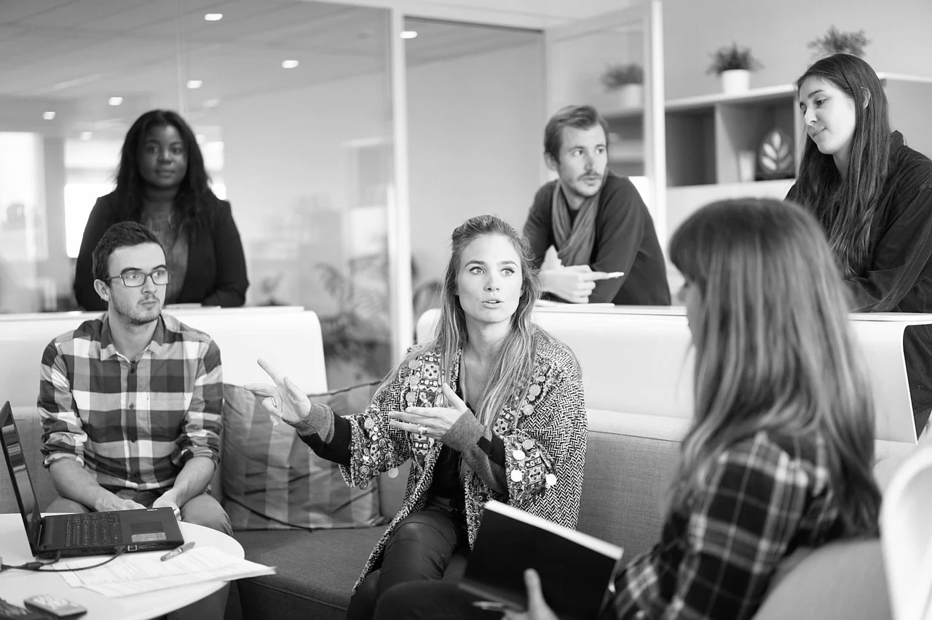
Is this a benefit of work?
I get to meet new people
Notes:
Discussion point: is meeting new people a positive or negative experience for the student?

Slide 11
Is this a benefit of work?
I get to watch TV
Notes:
Discussion point: is this ‘work’? Would this apply to any jobs? Security guard?

Slide 12
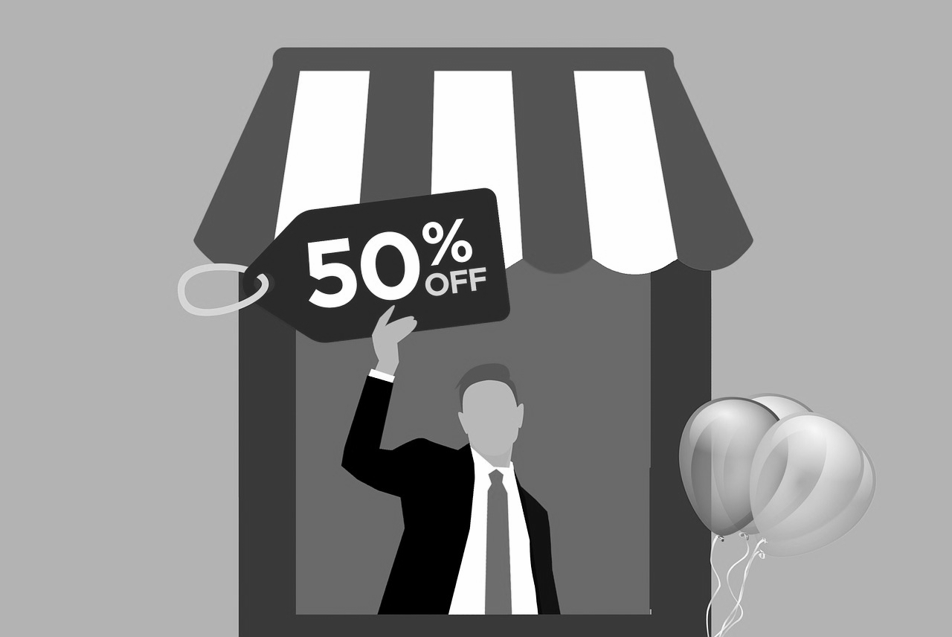
Is this a benefit of work?
I get a shop discount!
Notes:
Check that the student understands what ‘discount’ means (getting things for a cheaper amount)
Discussion point: is this an important or motivating benefit?

Slide 13
Is this a benefit of work?
I can turn up when I want
Notes:
Discussion point: how realistic is this?

Slide 14
Is this a benefit of work?
I get to chat to my friends all day
Notes:
Discussion point: can you chat with friends during the work day? Raise the idea that socialising is ok at certain times but it will be important that you get you complete your work. You might lead the student back to the discussion around ‘meeting new people’. Socialising is an important aspect of work, but perhaps not the only purpose.

Slide 15
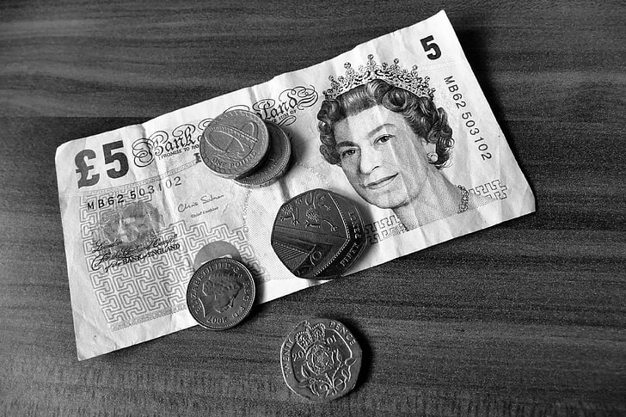
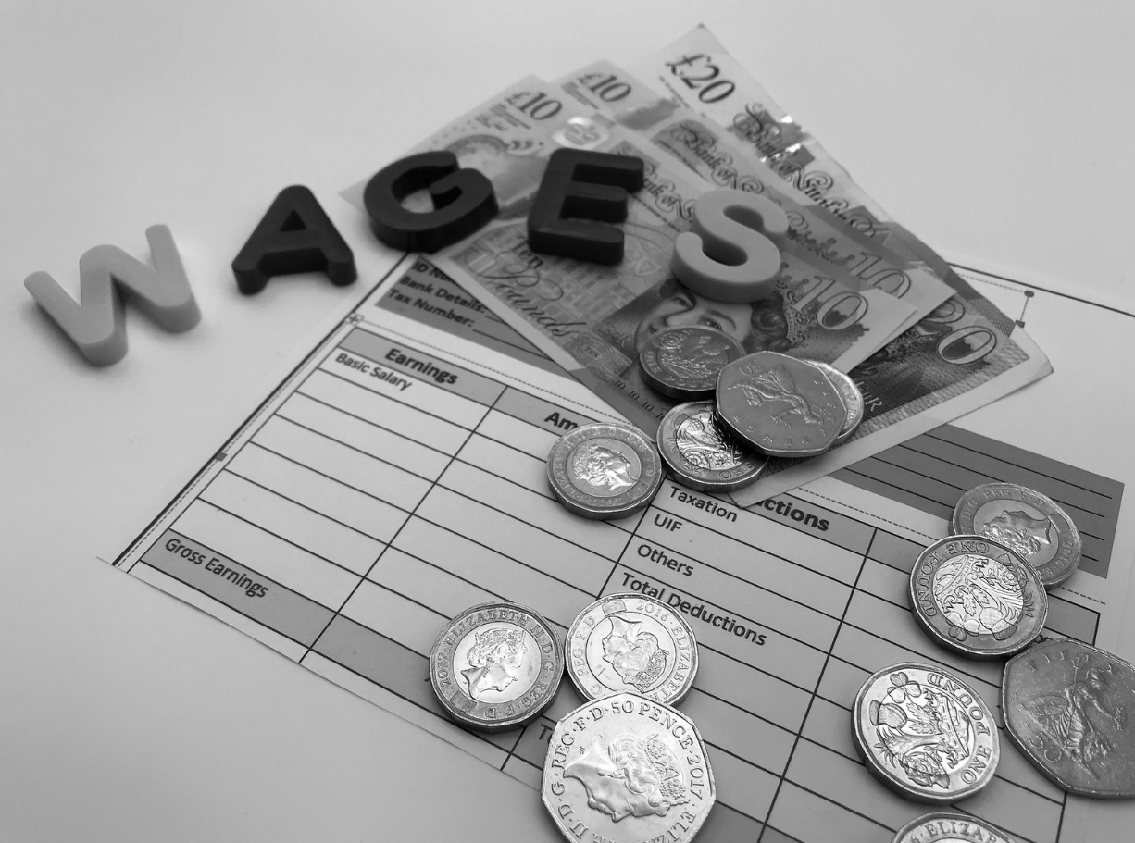
Is this a benefit of work?
I get paid
Notes:
Teaching point - money will be looked at in more detail in the next part of the lesson.

Slide 16
Part 2 - Do a task - get a reward
What can you do to help your household and earn a reward?
My task | My reward
Notes:
Decide what the student will do and what the reward will be. This may be money, a treat, verbal praise, time on a games console. The purpose of this exercise is to check that the student understands that working carries a ‘value’. If this is a financial reward, check the understanding that more work means more money, less work less money. If you spend money it won't get replaced until more work is completed.

Slide 17
Do a task - get a reward
Was it easy?
Was it enjoyable?
Did you enjoy your reward?
Notes:
Talking about how they felt (both positive and negative are very valid responses) is important because it will reinforce the learning intention. The purpose of this exercise is to check that the student understands that working carries a ‘value’. If this is a financial reward, check the understanding that more work means more money, less work less money. If you spend money it won't get replaced until more work is completed.

Slide 18
Part 3 - The challenges of work
It is OK and very normal to feel worried about work
Sharing your thoughts with someone else is important
Notes:
It is entirely normal to feel worried about new things. Reassure the student that being worried should not stop us trying something. There will always be people to help us

Slide 19
The challenges of work
Create a list of questions, concerns and thoughts about work under the following headings:
My questions about work | My concerns about work | Things I don't like about work
E.g. Will I have a lunch break? | E.g. Forgetting what I have to do | E.g. Early mornings
Notes:
Teaching point: All questions and feelings are valid, encourage honesty. Ask the student to keep hold of their list. When the time comes for them to experience the world of work in an authentic setting get them to check back with their list. Have some of their questions been answered, have their feelings or thoughts changed? What was better than expected what was worse?

Slide 20
Independent Living
World of Work
The benefits of work
Make it easier
Make it harder
More ideas
Only complete the task and reward section until the student understands the concept of ‘work’ and ‘reward’.
For each image in part 1 get the student to name a job where this benefit might apply.
For example: I would get a shop discount card if I worked in xxxx.
Can they keep a record of how much money they have coming in (pocket money, money for chores, birthday, etc) and how much they have going out (spending on clothes, games, phone credit etc). Make it visual.

Slide 21
Further Learning with Oak National
Independent Living:
World of Work- Behaviour in the workplace (Unit 5)
Applying learning- Managing Feelings (Unit 2)
Applying learning- Celebrating ourselves and each other (Unit 2)
Applying learning- Best value (Unit 4)
Numeracy:
Applying Learning- Money (Unit 6)

Slide 22
References
Slide 9- Stickpeople high five, Pixabay
Slide 10- Workplace team, Pixabay
Slide 11- Watching TV, Piqsels
Slide 12- Sale discount, Needpix
Slide 13- Yawning man, Wallace Chuch, Pexels
Slide 14- Happy woman talking on the phone, Rawpixel / Group of four girl friends, Good free photos
Slide 15- Bank notes, Wallpaper Flare / The word wages is spelled out with colourful letters, alongside a number of £1 coins, 50p coins and £10 and £20 notes and a UK payslip, One Click Group UK, Flickr Attribution 2.0 Generic (CC BY 2.0)

