Slide 1
Finding the Sum of Interior Angles in a Polygon
Maths
Miss Davies

Slide 2
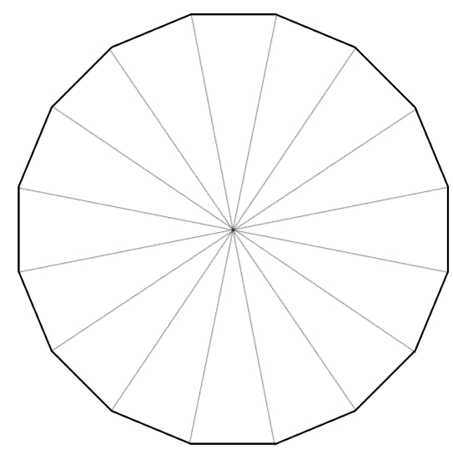
Finding the Sum of Interior Angles in a Polygon
1. Complete the table.
2. Nick is working out the sum of interior angles of a 16 sided shape.
Nick is wrong.
What mistake has he made?
Shape | Number of sides | Number of triangles | Sum of Interior angles
Quadrilateral | 4 | 2 | 360°
Pentagon
Nonagon
 |  | 8
 | 6
 |  | 6
 |  |  | 1800°
 | 20

Slide 3
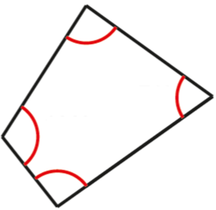
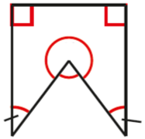
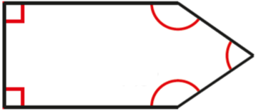
Finding the Sum of Interior Angles in a Polygon
3. Find the angle labelled x.
a) b)
c) d)
4. A polygon has n sides
a) Write an expression, in terms of n, to represent the number of triangles inside the polygon.
b) Write an expression, in terms of n, to represent the sum of interior angles of the polygon.
5. Calculate the size of each interior angle in a regular hexagon.
107º
83º
103º
72º
115º
119º
108º
123º
136º
136º
42º
42º

Slide 4
Answers

Slide 5
Finding the Sum of Interior Angles in a Polygon
1. Complete the table.
2. Nick is working out the sum of interior angles of a 16 sided shape.
Nick is wrong.
What mistake has he made?
Shape | Number of sides | Number of triangles | Sum of Interior angles
Quadrilateral | 4 | 2 | 360°
Pentagon | 5 | 3 | 540º
Nonagon | 9 | 7 | 1260º
Decagon | 10 | 8 | 1440º
Hexagon | 6 | 4 | 720º
Octagon | 8 | 6 | 1080º
Dodecagon | 12 | 10 | 1800°
Icosagon | 20 | 18 | 3240º
He has drawn the triangle wrong – there should be 14, as it needs to be the minimum number.

Slide 6
Finding the Sum of Interior Angles in a Polygon
3. Find the angle labelled x.
a) b)
c) d)
4. A polygon has n sides
a) Write an expression, in terms of n, to represent the number of triangles inside the polygon.
b) Write an expression, in terms of n, to represent the sum of interior angles of the polygon.
5. Calculate the size of each interior angle in a regular hexagon.
107º
83º
103º
n – 2
72º
115º
119º
108º
153º
123º
97º
136º
136º
120º
42º
84º
42º
88º

