Slide 1
Solving Quadratic Equations, Given a Different Quadratic, Using a Sketch
Maths
Miss Davies
Please note some slides do have colour font on them

Slide 2
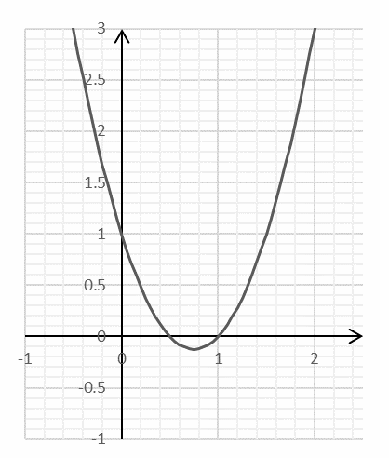
Plot quadratic equations

Slide 3
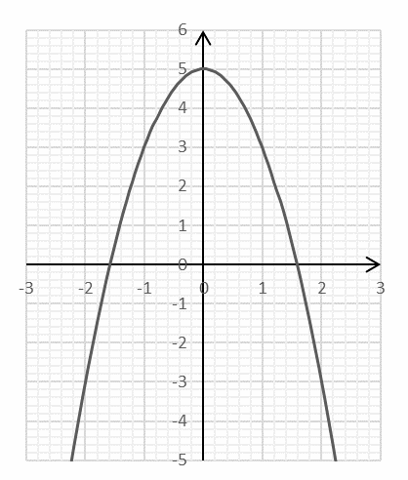
Plot quadratic equations

Slide 4
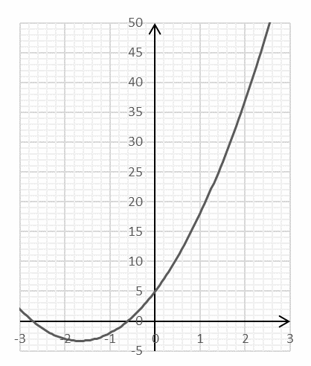
Plot quadratic equations

Slide 5
Answers

Slide 6
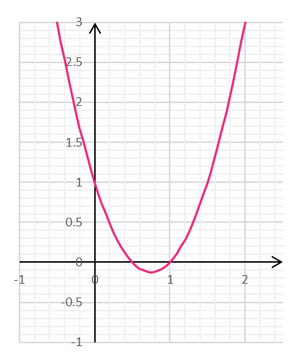
Plot quadratic equations

Slide 7
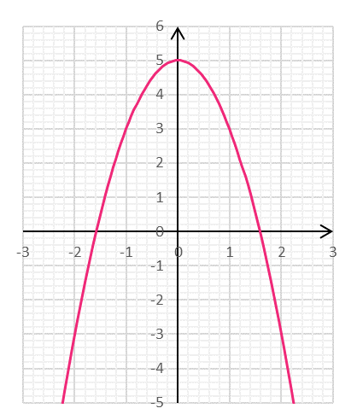
Plot quadratic equations

Slide 8
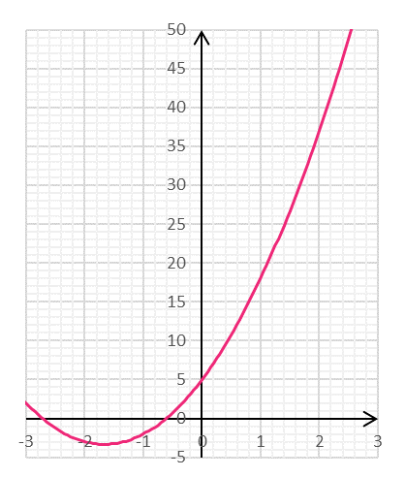
Plot quadratic equations

