Slide 1
Mathematics
Comparing numbers to 100
Miss Hughes

Slide 2
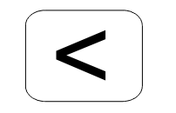
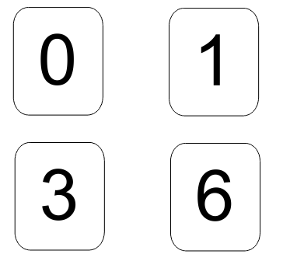
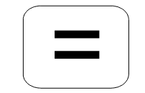
Independent Task
Is less than
Use these digits to create 2-digit numbers
Make the numbers to compare them with
<, > or =
Is equal to
Is more than
Notes:
Right team, we are now going to be comparing some 2-digit numbers and using our new signs to help us do this. So my first 2 numbers are 17 and 71. Beofre I can compare them, I am going to make my numbers. Now you can do this with a bead strign or any countable object - I am going to use dienes in a place value chart. So 17 has 1 ten and 7 ones. 10, 11, 12, 13, 14, 15, 1,6, 17. And 71 has 7 tens 10, 20, 30….70 and 01 one which makes 71.
Brilliant, now I can compare them. So I start by looking at the tens first and I can see striaght away that 7 tens is greater than 1 ten. I don;t need to look at my ones column because from my tens I can see that 71 is the greater number. 71 is greater than 17. 17 is les than 71. Now remeber, when I am using my signs, the smallest part always faces the smallest number and the largrer/ wider part always faces the greater number so I am going to use this sign. This shows that 17 is LESS THEN 71.
Let’s move onto the next one….. SO this means that 13 is less than 30. Hmmmm, what if I were to swtich the numbers around like this? Does my sign stay the same? Or will I need to change it? I will give you a few seconds thinking time…. So - I do need to change my sign because my greatest number is on the other side now and remember that the wider part of the sign always faces the greater number. With the sign this way round it is saying that 30 is leas then 13 and we know from our representations that that isn’t true! So lets switch our sign now! Perfect! Now it says 30 is greater than 13.
LET’s look at our last set of numbers… SO they both have an equal number of tens - - so I can’t tell yet which one is bigger which means I need to look at my ones now. Oh - and they have the same number of ones! Becuase they have an equal number of tens and ones, I know that 35 and 35 are the same, they are equal to one another - so I need to use this sign. This shows that 35 is equal to 35.
QUESTION: which sign should be used between the numbers and ask pupils to explain why

Slide 3
Independent Task - Resources
tens
ones
tens
ones
tens
ones
tens
ones
tens
ones
tens
ones
tens
ones
tens
ones
Notes:
Right team, we are now going to be comparing some 2-digit numbers and using our new signs to help us do this. So my first 2 numbers are 17 and 71. Beofre I can compare them, I am going to make my numbers. Now you can do this with a bead strign or any countable object - I am going to use dienes in a place value chart. So 17 has 1 ten and 7 ones. 10, 11, 12, 13, 14, 15, 1,6, 17. And 71 has 7 tens 10, 20, 30….70 and 01 one which makes 71.
Brilliant, now I can compare them. So I start by looking at the tens first and I can see striaght away that 7 tens is greater than 1 ten. I don;t need to look at my ones column because from my tens I can see that 71 is the greater number. 71 is greater than 17. 17 is les than 71. Now remeber, when I am using my signs, the smallest part always faces the smallest number and the largrer/ wider part always faces the greater number so I am going to use this sign. This shows that 17 is LESS THEN 71.
Let’s move onto the next one….. SO this means that 13 is less than 30. Hmmmm, what if I were to swtich the numbers around like this? Does my sign stay the same? Or will I need to change it? I will give you a few seconds thinking time…. So - I do need to change my sign because my greatest number is on the other side now and remember that the wider part of the sign always faces the greater number. With the sign this way round it is saying that 30 is leas then 13 and we know from our representations that that isn’t true! So lets switch our sign now! Perfect! Now it says 30 is greater than 13.
LET’s look at our last set of numbers… SO they both have an equal number of tens - - so I can’t tell yet which one is bigger which means I need to look at my ones now. Oh - and they have the same number of ones! Becuase they have an equal number of tens and ones, I know that 35 and 35 are the same, they are equal to one another - so I need to use this sign. This shows that 35 is equal to 35.
QUESTION: which sign should be used between the numbers and ask pupils to explain why

Slide 4
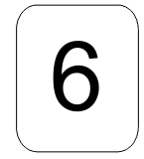
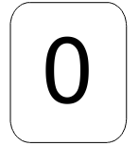
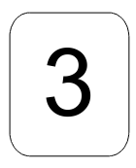
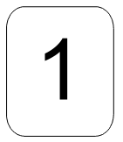
Independent Task - Example Answers
Is less than
Is equal to
Is more than
Notes:
Right team, we are now going to be comparing some 2-digit numbers and using our new signs to help us do this. So my first 2 numbers are 17 and 71. Beofre I can compare them, I am going to make my numbers. Now you can do this with a bead strign or any countable object - I am going to use dienes in a place value chart. So 17 has 1 ten and 7 ones. 10, 11, 12, 13, 14, 15, 1,6, 17. And 71 has 7 tens 10, 20, 30….70 and 01 one which makes 71.
Brilliant, now I can compare them. So I start by looking at the tens first and I can see striaght away that 7 tens is greater than 1 ten. I don;t need to look at my ones column because from my tens I can see that 71 is the greater number. 71 is greater than 17. 17 is les than 71. Now remeber, when I am using my signs, the smallest part always faces the smallest number and the largrer/ wider part always faces the greater number so I am going to use this sign. This shows that 17 is LESS THEN 71.
Let’s move onto the next one….. SO this means that 13 is less than 30. Hmmmm, what if I were to swtich the numbers around like this? Does my sign stay the same? Or will I need to change it? I will give you a few seconds thinking time…. So - I do need to change my sign because my greatest number is on the other side now and remember that the wider part of the sign always faces the greater number. With the sign this way round it is saying that 30 is leas then 13 and we know from our representations that that isn’t true! So lets switch our sign now! Perfect! Now it says 30 is greater than 13.
LET’s look at our last set of numbers… SO they both have an equal number of tens - - so I can’t tell yet which one is bigger which means I need to look at my ones now. Oh - and they have the same number of ones! Becuase they have an equal number of tens and ones, I know that 35 and 35 are the same, they are equal to one another - so I need to use this sign. This shows that 35 is equal to 35.
QUESTION: which sign should be used between the numbers and ask pupils to explain why

