Slide 1
Maths
Mr Bond

Slide 2
 |  |  | 0 | 1 | 2
‹#›

Slide 3
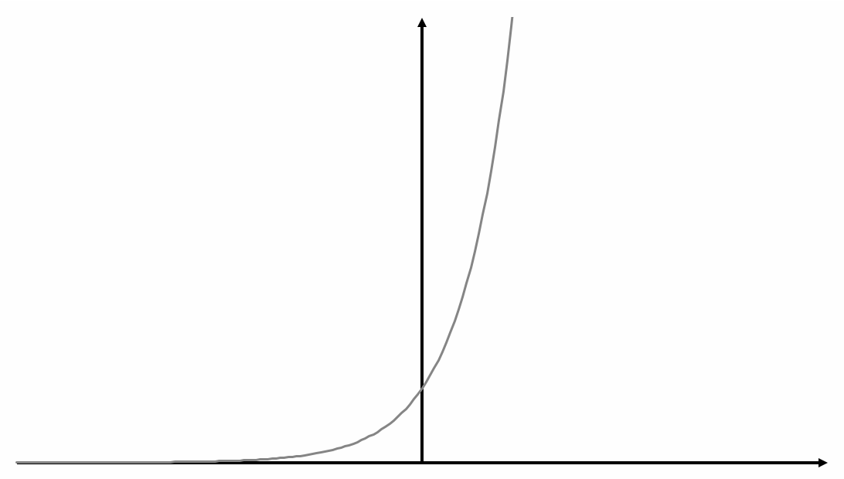
‹#›

Slide 4
Answers

Slide 5
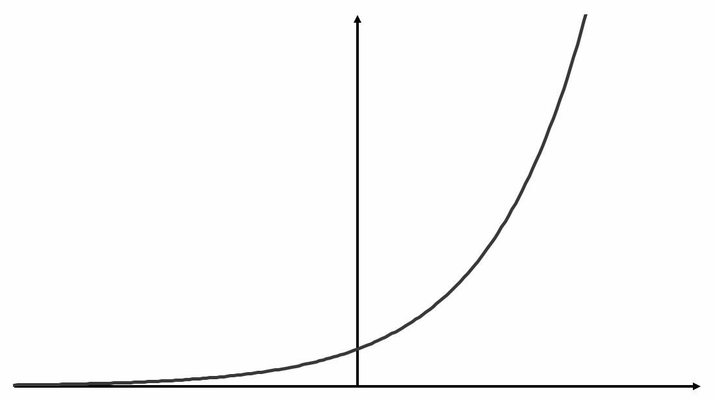
 |  |  | 0 | 1 | 2
0.25
0.5
1
2
4
Always
Never
Sometimes
‹#›

Slide 6
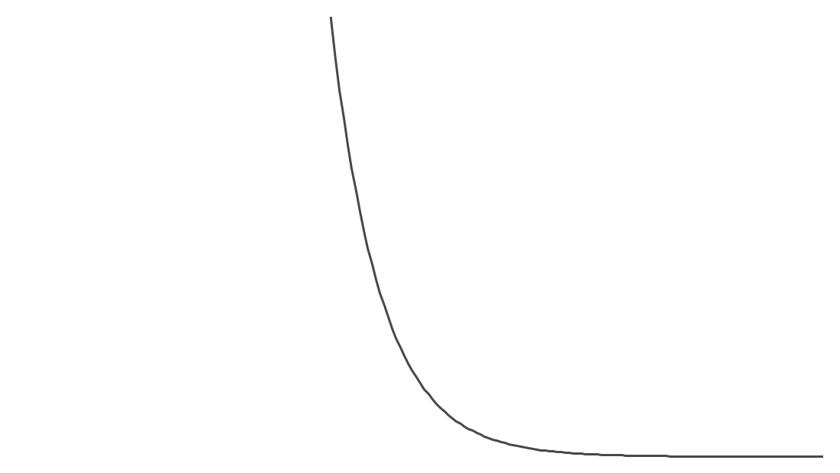
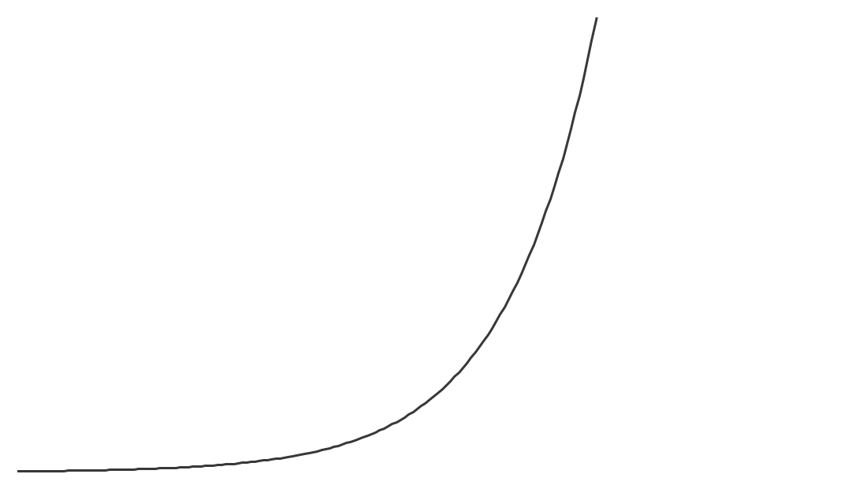
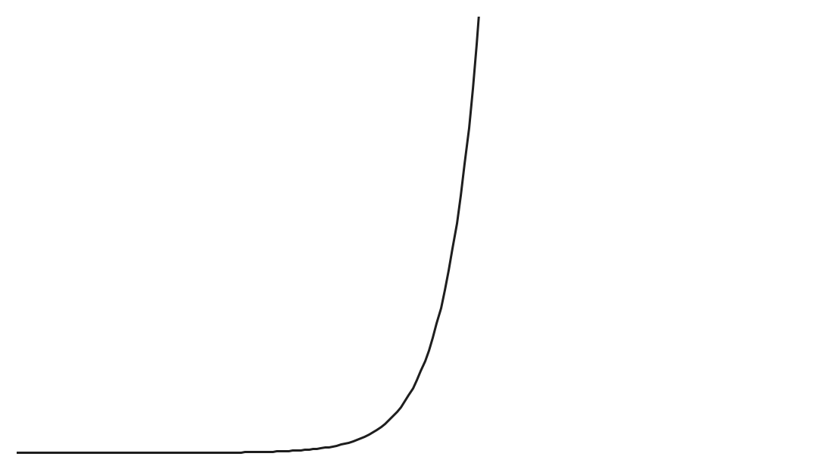
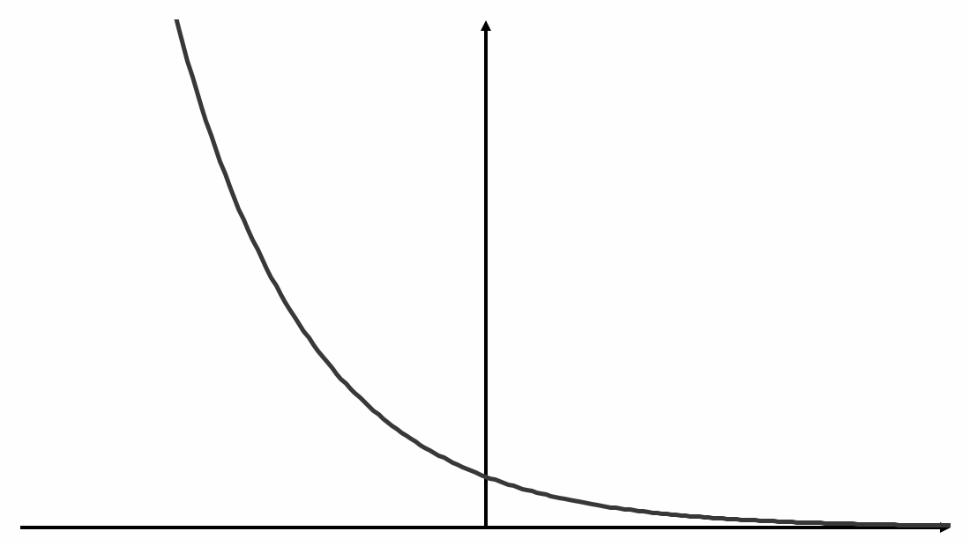
𝑦=0.2^{𝓍}
𝑦=10^{𝓍}
𝑦=2.5^{𝓍}
‹#›

