Slide 1
Rounding to significant figures
Downloadable Resource
Mathematics
Miss Oreyomi

Slide 2
Questions

Slide 3
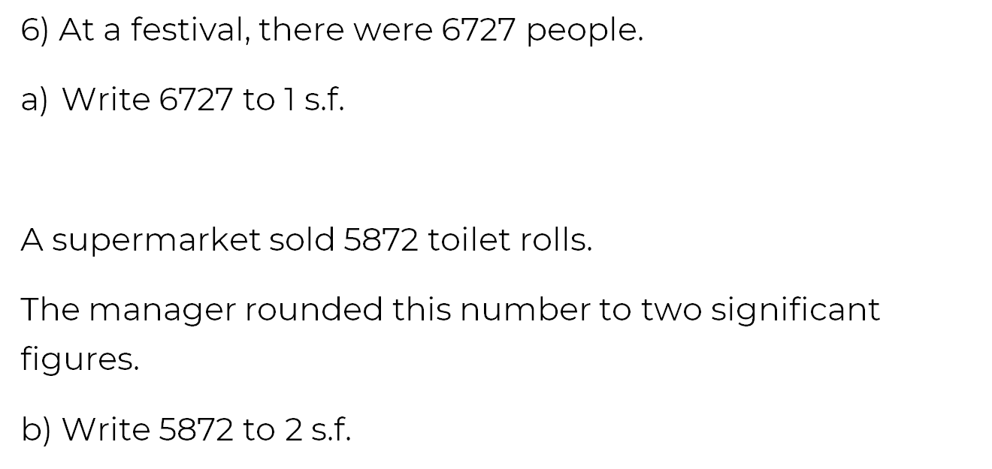
Questions

Slide 4
Questions

