Slide 1
Consolidating addition and subtraction of 2-digit numbers
Mathematics
Miss Hughes

Slide 2
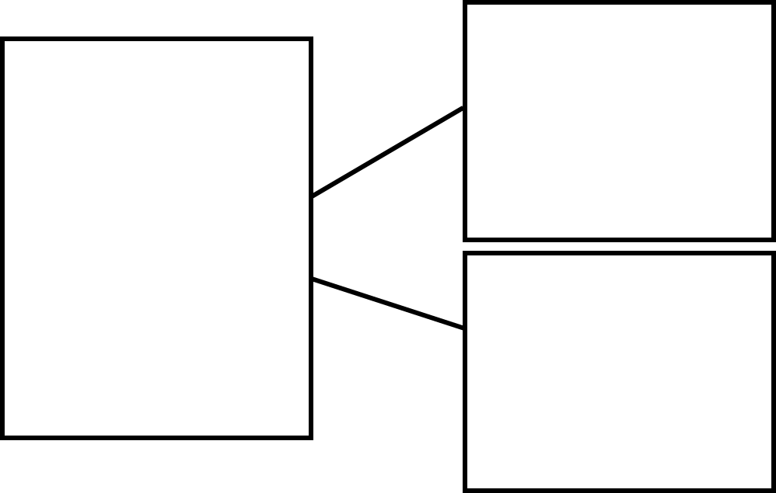
Part Whole Model
Notes:
Model on camera.

Slide 3
Task
71 + 32 =
43 + 25 =
28 + 51 =
64 + 32 =
The number bond for the ones is _____ + _____ = _____
The number bond for the tens is _____ + _____ = _____.
_____ + _____ = _____
Notes:
Model on camera.

Slide 4
Task
72 - 31 =
45 - 24 =
58 - 21 =
64 - 32 =
The number bond for the ones is _____ - _____ = _____
The number bond for the tens is _____ - _____ = _____.
_____ - _____ = _____
Notes:
Model on camera.

Slide 5
Main Task
On Friday, 67 people were in town and 24 people left for work. How many people were still in town?
On Monday, 56 people were in town and 12 people were in their homes. How many people were there altogether?
On Wednesday, 56 people were in town and 12 people left for work. How many people were still in town?
Notes:
Model on camera.

