Slide 1
Independent Task
To identify angles within shapes
Maths
Mr Critchlow

Slide 2
To Start
Take a look at the sequences below, can you complete them by filling in the missing numbers and saying the rule. The first one has been done for you.
Sequence | Rule
25, 30, 35, 40, 45, 50 | Adding 5 every time
____, 104, 106, ____, ____, 112
10, 9.8, 9.6, ____, ____, 9, ____
13, ____, ____, 22, 25, ____, 31
2000, 1000, 500, ____, 125, ____
316, 304, 292, ____, ____, ____
13, 26, ____, 104,____ , ____, 832

Slide 3
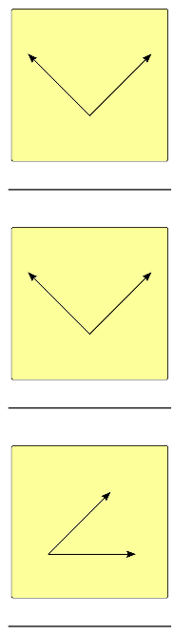
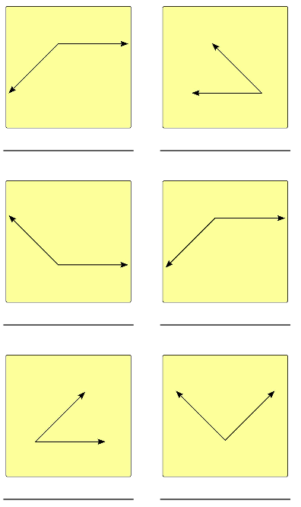
Moving On - label the angles as acute, obtuse or right angle

Slide 4
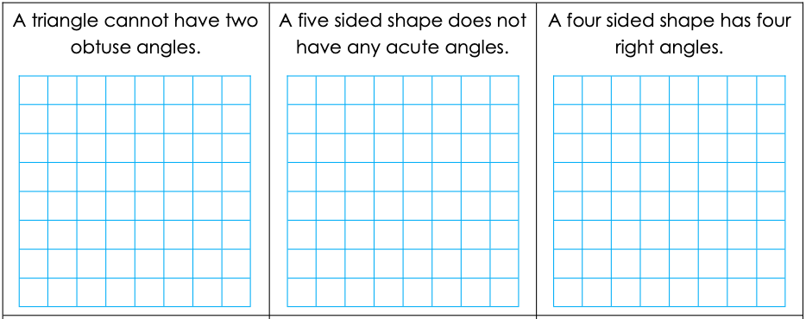
Main Task - 1
Read the statements carefully. You must decide if they are SOMETIMES true, ALWAYS true or NEVER true. Use a diagram or 2 for each to prove your thinking.

Slide 5
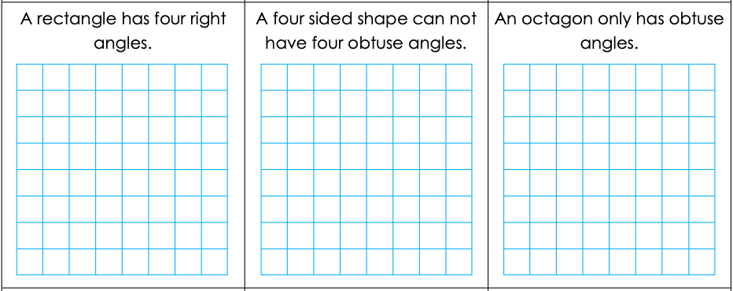
Main Task - 2
Read the statements carefully. You must decide if they are SOMETIMES true, ALWAYS true or NEVER true. Use a diagram or 2 for each to prove your thinking.

Slide 6
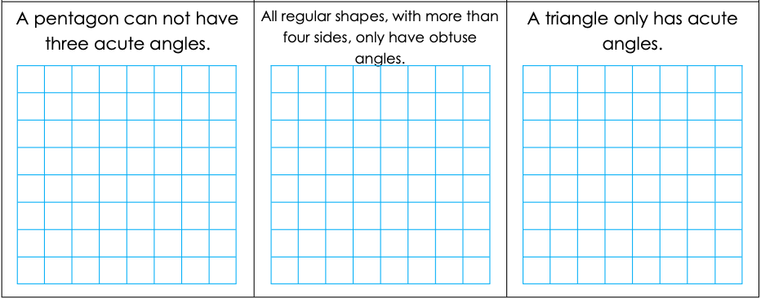
Main Task - 3
Read the statements carefully. You must decide if they are SOMETIMES true, ALWAYS true or NEVER true. Use a diagram or 2 for each to prove your thinking.

