Slide 1
Mathematics
Transformations: Reflections Worksheet
Mrs Buckmire

Slide 2
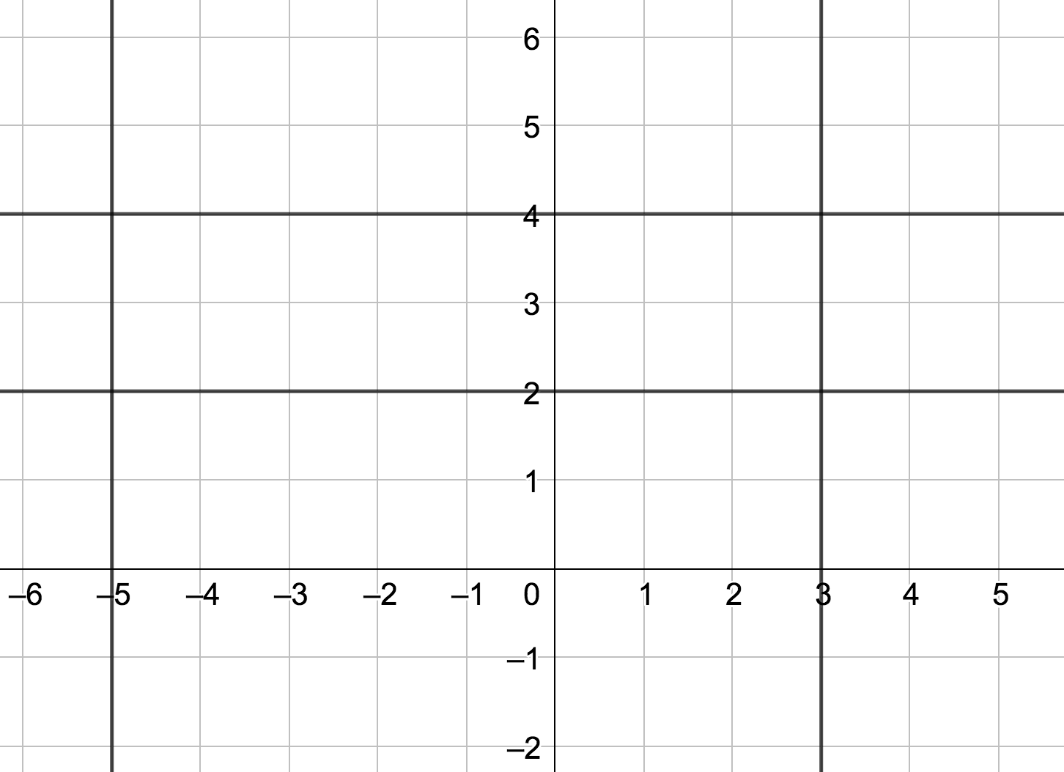
Try this
A
Three coordinates that lie on the line, with at least one off the grid.
B
The equation of the line.

Slide 3
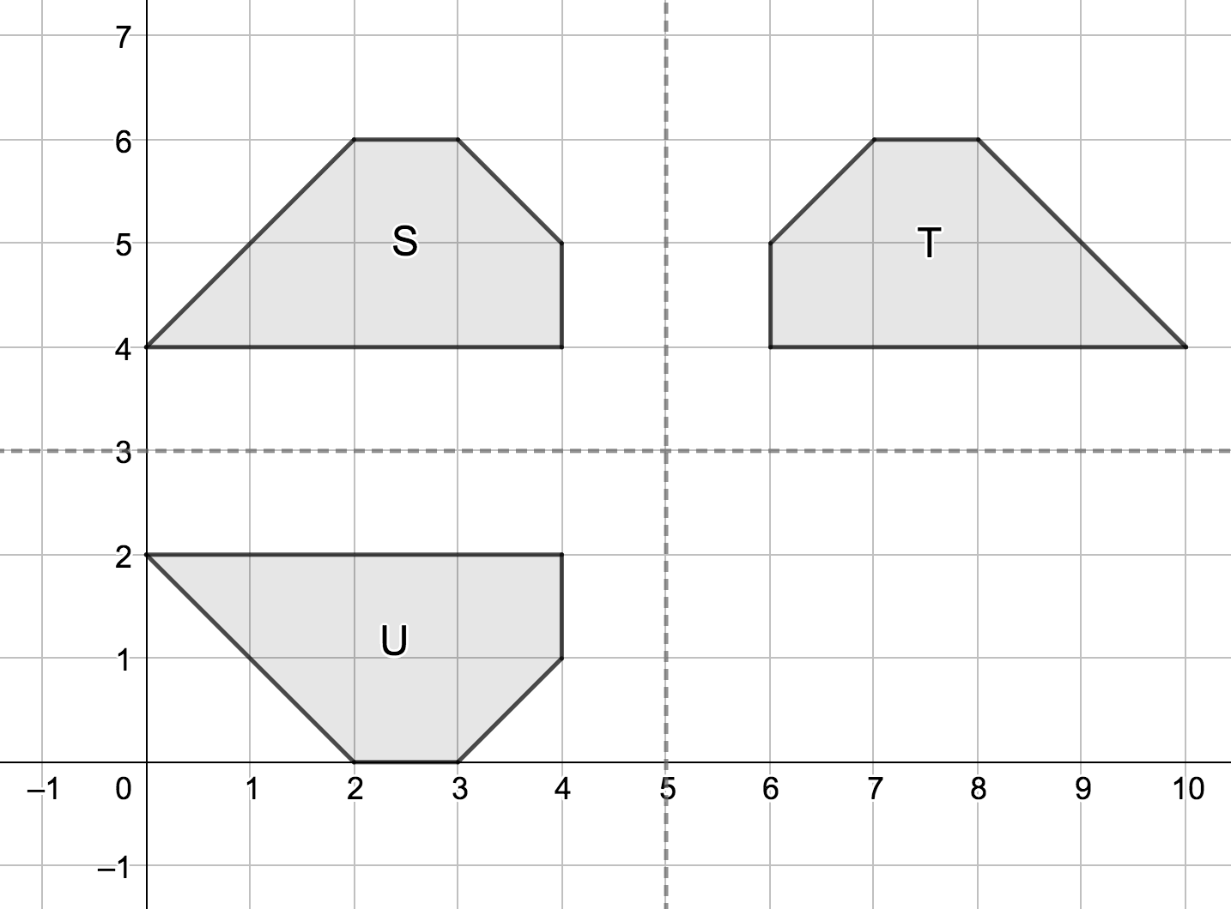
Connect
T and U are reflections of S. What are the lines of reflection?
Explore the effect on the reflected images if S is translated by the vectors:
If S translated by:
… T translated by:
… U translated by:

Slide 4
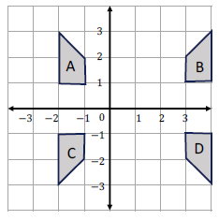
Independent task (page 1 of 2)
Describe the following transformations:
A to B
b) B to D
c) A to C
d) C to B

Slide 5
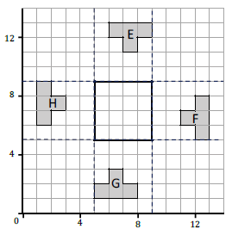
Independent task (page 2 of 2)
Reflect the octagons E,F,G and H so that they form a tessellation inside the square.
Describe the four reflections.

Slide 6
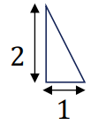
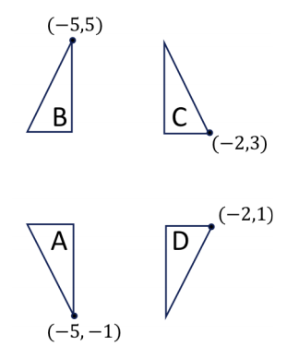
Explore
Four copies of the triangle are arranged as follows:
Describe the transformation from B to C.
Describe the transformation from C to D.
Describe the transformation from D to B.

