Slide 1
Unit 8: Decimals
Multiplying and Dividing by 100
Independent Task
Mathematics
Lesson 14 of 15
Mr Whitehead

Slide 2
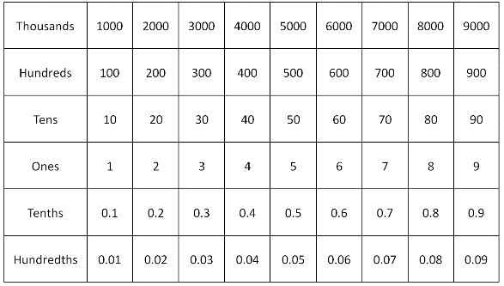
Use the chart to make up 5 sets of instructions.
Example: I start with the number 0.4. I multiply by one hundred and then add twenty. I divide by ten and minus 5. I divide by 100. What number have I ended up on?
Rules
You can use addition, subtraction and multiplication/division by 100.
Through your instructions, move up/down and left/right only.

