Slide 1
Mathematics
Multiply a fraction by a whole number
Mr Kelsall

Slide 2
New learning: multiplying fractions
Ciaran spends a quarter of an hour running.
He runs three times per week.
How long does he spend running?
Draw Model
Repeated addition Multiplication
Fraction Number line

Slide 3
New learning: multiplying fractions
One blink of an eye takes 3/10 of a second.
How long will three blinks take?
Draw Model
Repeated addition Multiplication
Fraction Number line

Slide 4
New learning: multiplying fractions
How would you solve these calculations?
Can you draw them?
1/5 x 3 2/9 x 4 3 x 2/7

Slide 5
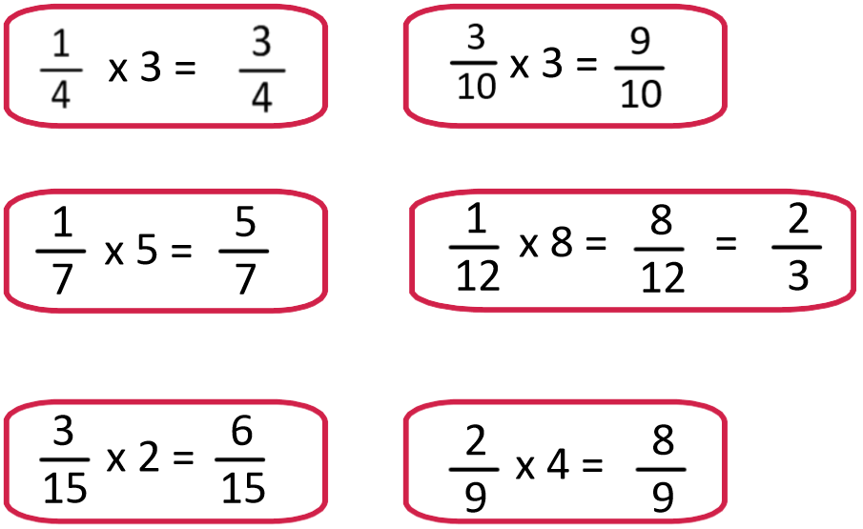
Develop learning: multiplying fractions
What do you notice about these calculations?

Slide 6
Develop learning: multiplying fractions
One cup holds a quarter of a litre of liquid, how much liquid will five cups hold?
How is this questions different to previous ones?

Slide 7
Develop learning: multiplying fractions
A ribbon is ⅔ of a metre long. Another ribbon is five times the length, how long is it?

Slide 8
Independent task: multiplying fractions

Slide 9
Independent task: multiplying fractions

