Slide 1
How can we use our body as an instrument?
Music Unit 1 Lesson 5
Miss Al-Hanoush

Slide 2
Composing your own body percussion section
Intro | Main Groove | Your own section | Outro
Uses addition Builds up | Repeats x 4 |  | Uses subtraction Breaks down

Slide 3
Composing your own body percussion section
1 | 2 | 3 | 4 | 5 | 6 | 7 | 8
9 | 10 | 11 | 12 | 13 | 14 | 15 | 16

Slide 4
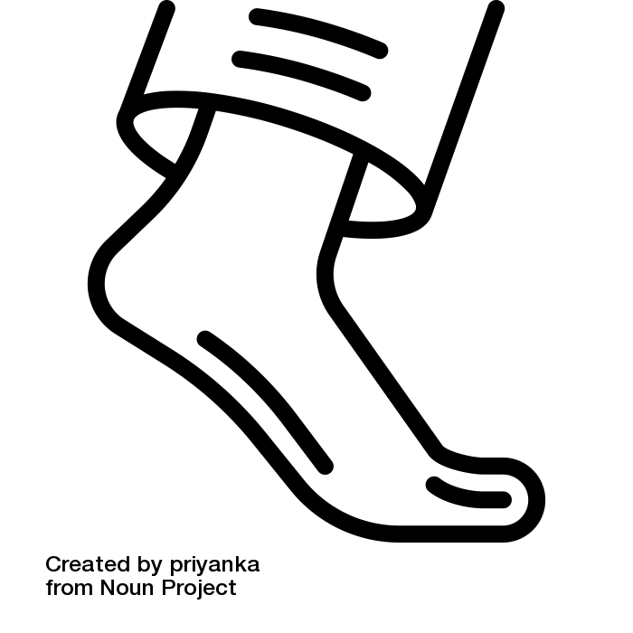
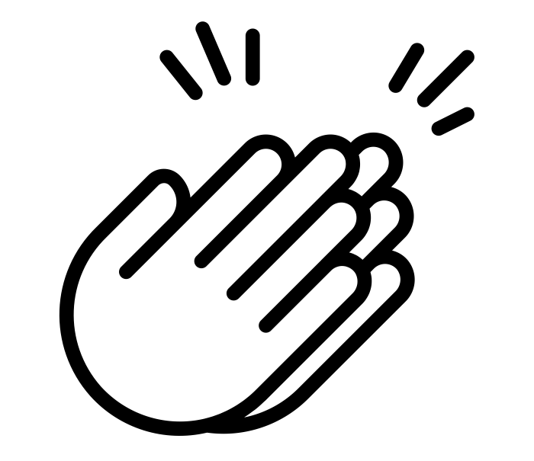
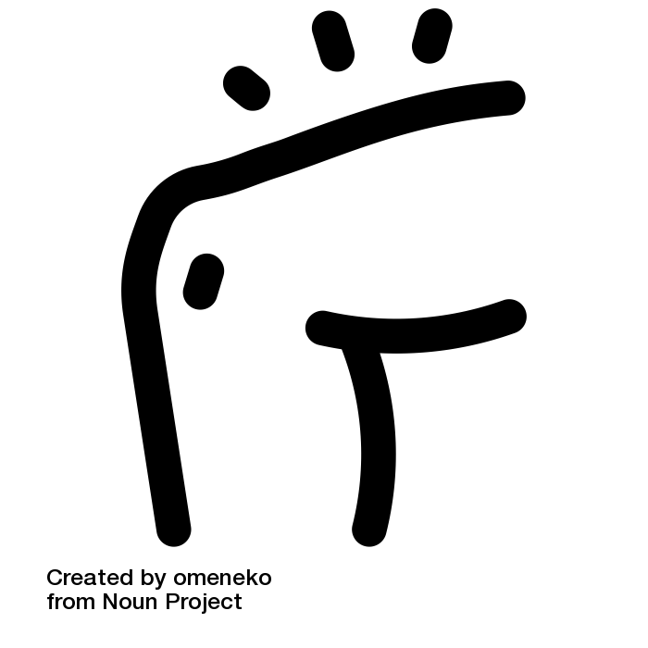
Body percussion piece (using notation)
St = Stamp
Cl = Clap
Sl = Thigh Slap
Intro
Main Groove
Outro
[The Noun Project] - [Berkah Icon] - [clap]
[The Noun Project] - [priyanka] - [foot]
[The Noun Project] -[omeneko] - [thigh]

