Slide 1
Domestic Electricity
Worksheet
Combined Science - Physics - Key Stage 4 - Electricity
Miss Walrond

Slide 2
Q1.
Batteries supply direct current (d.c).
Another type of current is alternating current (a.c).
Each statement in the table below may be true about d.c, or true about a.c, or true for both d.c and a.c.
Put a tick (✓) in the correct box in each row. [2]
 | True only for d.c | True only for a.c | True for both
The current always flows in the same direction.
The domestic supply in the UK uses this.
OCR, Twenty First Century Science B, Paper j259/01, June 2018.

Slide 3
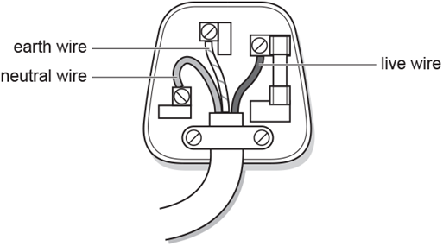
Q1.
(b) The diagram shows the inside of a three-pin plug.
i. Put a tick (✓) in the correct box in each row to show the correct descriptions of the live, neutral and earth wires.
[2]
Wire | Connected to the National Grid | Is at the same voltage as the ground
Live
Neutral
Earth
OCR, Gateway Physics A, Paper j259/01, June 2018.

Slide 4
Q1.
ii. Put a around the voltage between the live and neutral wires.
0 V 12 V 230 V 25 000 V
[1]
OCR, Gateway Physics A, Paper j259/01, June 2018.

Slide 5
Answers

Slide 6
Q1.
 | True only for d.c | True only for a.c | True for both
Current always flows in the same direction. | ✓
The domestic supply in the UK uses this. |  | ✓
2

Slide 7
Q1.
b. i. 2
b. ii. 230 V 1
Wire | Connected to National Grid | Is at the same voltage as the ground
Live | ✓
Neutral | ✓
Earth |  | ✓

Slide 8
In lesson questions

Slide 9
Direct Current (d.c.)
What is direct current?
Give one source of direct current.
Copy the sketch graph to the right.
Draw a line to show a direct potential difference source of 3V.

Slide 10
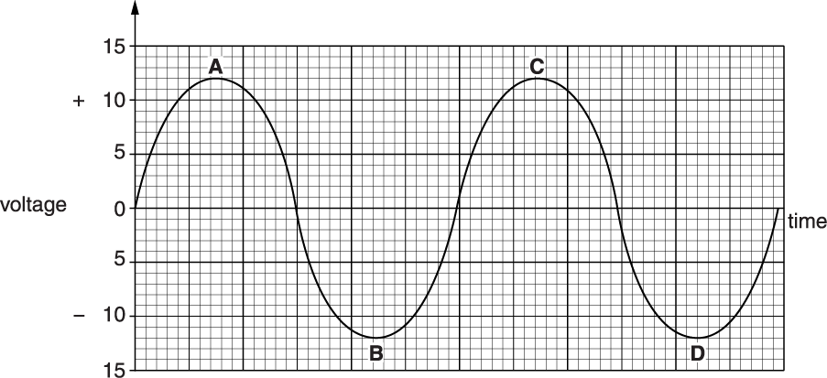
Alternating current (a.c.)
What is alternating current?
Give one source of alternating current.
Copy the sketch graph to the right.
Draw a double ended arrow to show the peak voltage.

Slide 11
Mains electricity
The UK mains electricity supply has a potential difference of about 230 V and a frequency of 50 Hz.
In Trinidad and Tobago, their electricity has a potential difference of about 115 V and a frequency of 60 Hz.
Explain the differences between the two supplies.

Slide 12
3-core cable
Name the red, blue and green/yellow striped wires.
What material is the wire made of?
What material is the insulation made of?

Slide 13
Independent Task: The 3 pin plug
Write down the names of labels 1-5.
Write down the materials of labels 1-4.
What is the purpose of the earth wire?

Slide 14
Double Insulation
Describe what is meant by double insulation.

Slide 15
Answers

Slide 16
Review: Direct Current (d.c.)
Direct current is when the electrons all travel in one direction around a circuit.
An example of a direct current source is a cell or a battery.

Slide 17
Review: Alternating Current (a.c.)
Alternating current is when the current changes direction many times a second.
An example of an alternating current source is the mains supply in your house.

Slide 18
Review: Mains Electricity
The power supply in Trinidad and Tobago has a lower peak voltage at 115 V compared to 230 V in the UK.
The frequency of the power supply is higher in Trinidad and Tobago though at 60 Hz compared to 50Hz in the UK.

Slide 19
Review: 3-core cable
The brown wire is the live wire.
The blue wire is the neutral wire.
The green/yellow striped wire is the earth wire.
The wires are made of copper.
The insulation is made of plastic.

Slide 20
Review - Independent Task: The 3 pin plug
1 - cable grip - plastic
2 - neutral wire pin - brass
3 - earth wire pin - brass
4 - live wire pin - brass
5- fuse
The earth wire connects the outer case of an appliance to the ground. It will direct current away from the appliance if there is a fault.

Slide 21
Review: Double Insulation
Double insulation is where an appliance has the internal electronics completely encased in plastic. This is underneath the outer casing.

