Slide 1
Gabriel’s problem
Mathematics
Mr Millar

Slide 2
Each blue box is the product of the 3 numbers in that row or column.
For example, 6 x 8 x 3 = 144.
Complete the other blue boxes.
6 | 8 | 3 | 144
7 | 1 | 5
2 | 9 | 4

Slide 3
Again, each blue box is the product of the 3 numbers in that row or column.
Complete the other boxes.
4 | 3 | 5
8 |  |  | 336
1 |  | 9 | 18
 | 42
I will need to use division as well as multiplication here...

Slide 4
Again, each blue box is the product of the 3 numbers in that row or column.
Complete the other boxes.
9 | 3 |  | 162
 |  | 2 | 14
 |  |  | 160
45 |  | 96

Slide 5
Again, each blue box is the product of the 3 numbers in that row or column.
Complete the other boxes.
 |  |  | 24
 |  |  | 40
 |  |  | 378
60 | 21 | 288
I know where the 5 goes by thinking about which numbers 5 is a factor of

Slide 6
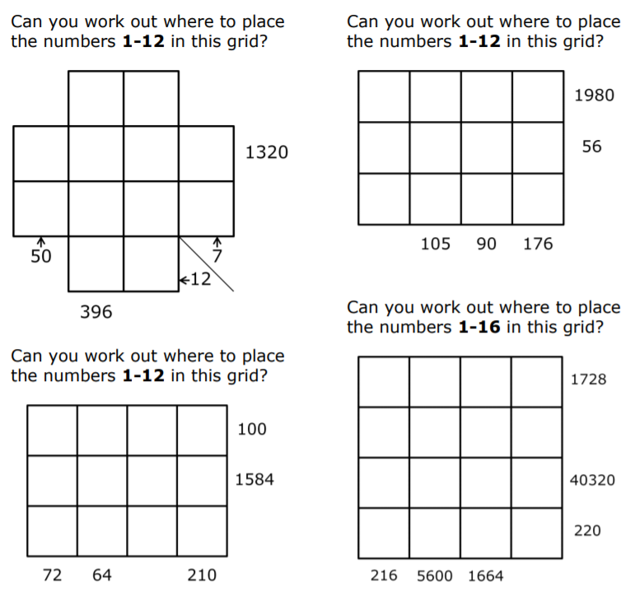
(Additional questions)

Slide 7
Answers

Slide 8
Each blue box is the product of the 3 numbers in that row or column.
For example, 6 x 8 x 3 = 144.
Complete the other blue boxes.
6 | 8 | 3 | 144
7 | 1 | 5 | 35
2 | 9 | 4 | 72
84 | 72 | 60

Slide 9
Again, each blue box is the product of the 3 numbers in that row or column.
Complete the other boxes.
4 | 3 | 5 | 60
8 | 7 | 6 | 336
1 | 2 | 9 | 18
32 | 42 | 270
I will need to use division as well as multiplication here...

Slide 10
Again, each blue box is the product of the 3 numbers in that row or column.
Complete the other boxes.
9 | 3 | 6 | 162
1 | 7 | 2 | 14
5 | 4 | 8 | 160
45 | 84 | 96

Slide 11
Again, each blue box is the product of the 3 numbers in that row or column.
Complete the other boxes.
2 | 3 | 4 | 24
5 | 1 | 8 | 40
6 | 7 | 9 | 378
60 | 21 | 288
I know where the 5 goes by thinking about which numbers 5 is a factor of

