Slide 1
Mathematics
Representing simultaneous equations graphically (1)
Independent Task
Ms Jones

Slide 2
Write an equation to match each of the student’s statements.
I’m thinking of two numbers that have a sum of 10.
I’m thinking of two numbers. I triple the first and add it to the second to get 15.

Slide 3
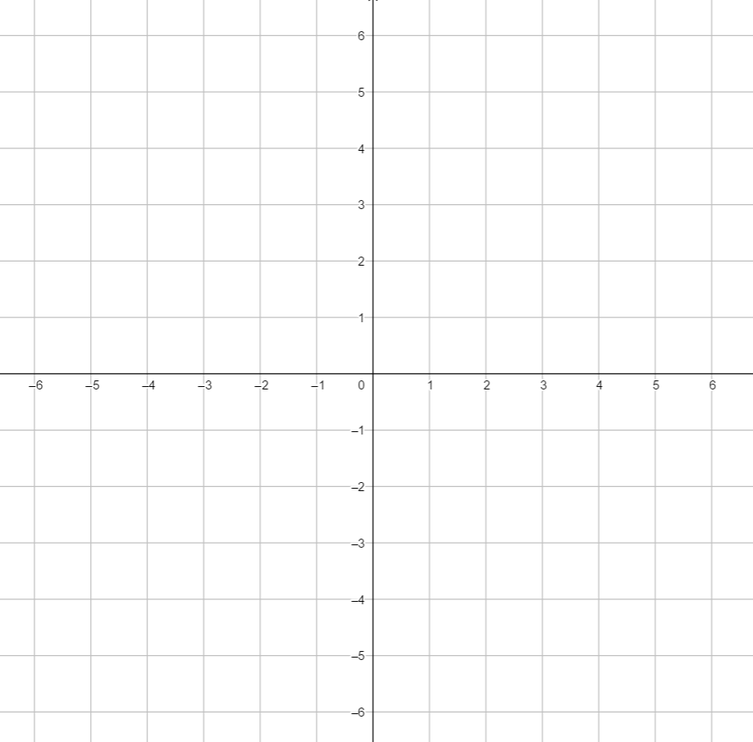
I’m thinking of two numbers. I double the first and add it to the second to get 10.
1.
Write an equation to match each of the student’s statements.
Represent those equations on a graph.
What values of x and y are true for both statements?
2. What values of x and y are true for both statements?
I’m thinking of two numbers that have a sum of 5.
I’m thinking of two numbers that have a difference of 1.
I’m thinking of two numbers. I double the first and add it to the second to get 2.

Slide 4
Create similar “think of a number problems” and solve graphically
I’m thinking of two numbers that have a sum of ___.
I’m thinking of two numbers. I ____ the first and add it to the second to get ____.

