Slide 1
Interpret timetables and distance tables
Miss Parnham
Maths

Slide 2
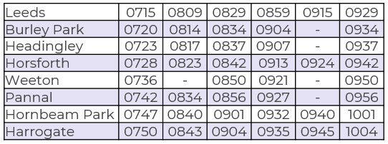
Interpret timetables and distance tables
1. Here is part of a train timetable.
a) Ron travels from Headingley to Harrogate and must arrive by 10am, what is the latest train he can catch?
b) How long should it take him?
2. Here is part of a tram timetable.
All journeys between stops take the same amount of time, complete the missing times.
Middlewood |  | 0908 |  | 0931
Hillsborough | 0906 |  |  | 0937
Shalesmoor | 0912 |  | 0932
Cathedral | 0921 | 0929
Castle Square |  | 0930 | 0942

Slide 3
Interpret timetables and distance tables
3. This chart shows the distance in km between Scottish cities.
a) Which two cities are 167 km apart?
b) Mo travels from Perth to Glasgow via Edinburgh, how much further is it than going directly?
4. Complete the mileage chart showing the distance between five consecutive M1 motorway services.
Aberdeen
106
194 | 90
233 | 128 | 73
167 | 204 | 251 | 258
139 | 34 | 70 | 94 | 180
193 | 88 | 62 | 44 | 218 | 54
Dundee
Edinburgh
Glasgow
Leicester
Forest East
Inverness
Perth
Trowell
Tibshelf
Stirling
42 | 14
 |  | 13
 |  |  | 33
Woodall
Woolley Edge

Slide 4
Answers

Slide 5
Interpret timetables and distance tables
1. Here is part of a train timetable.
a) Ron travels from Headingley to Harrogate and must arrive by 10am, what is the latest train he can catch?
b) How long should it take him?
2. Here is part of a tram timetable.
All journeys between stops take the same amount of time, complete the missing times.
Middlewood |  | 0908 |  | 0931
Hillsborough | 0906 |  |  | 0937
Shalesmoor | 0912 |  | 0932
Cathedral | 0921 | 0929
Castle Square |  | 0930 | 0942
0900
0920
0914
0926
0920
0943
0941
0952
0907 from Headingley, arriving 0935 in Harrogate
0922
0953
28 minutes

Slide 6
Interpret timetables and distance tables
3. This chart shows the distance in km between Scottish cities.
a) Which two cities are 167 km apart?
b) Mo travels from Perth to Glasgow via Edinburgh, how much further is it than going directly?
4. Complete the mileage chart showing the distance between five consecutive M1 motorway services.
Aberdeen
106
194 | 90
233 | 128 | 73
167 | 204 | 251 | 258
139 | 34 | 70 | 94 | 180
193 | 88 | 62 | 44 | 218 | 54
Dundee
Edinburgh
Glasgow
Leicester
Forest East
Inverness
Perth
Trowell
Tibshelf
Stirling
42 | 14
 |  | 13
 |  |  | 33
Aberdeen
and
Inverness
28
Woodall
55
27
88
60
46
Woolley Edge

