Slide 1
How do we know we are listening to Baroque music?
Notes:
Welcome! Excited to be your music teacher today. Name, what I play.
In this lesson, you will need:
A piece of paper
A pencil
An instrument or app to play on iPhone – virtual piano + & the piano keyboard (has recording feature)
Android – Perfect piano
Desktop – onlinepianist.com /virtual-piano
If you’ve not got these items to hand, pause the video, go and get them and then rejoin us.

Slide 2
Contrapuntal texture
Contrapuntal texture is the same as Polyphonic texture, but mainly in Baroque music. There are strict rules on how the melodies should fit together.

Slide 3
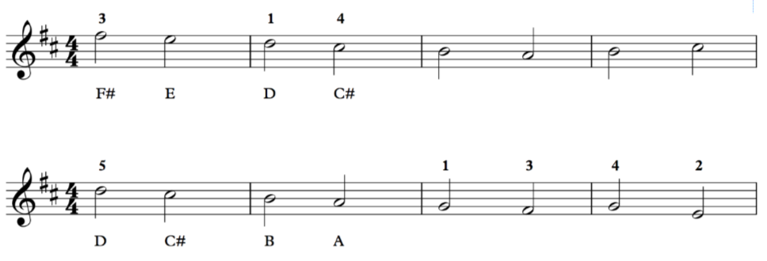
Melodies 1 and 2
1
B A B C#
2
G F# G E
Notes:
Play eg. from garageband (keyboard)
Students write down answer

Slide 4
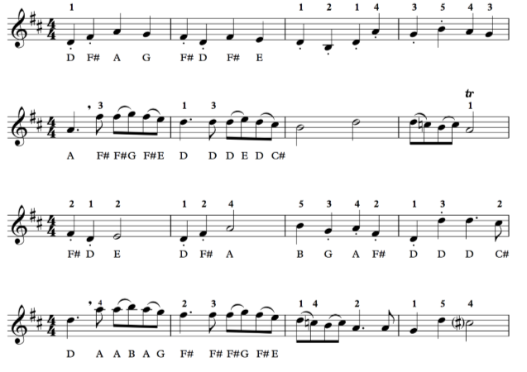
3
4
5
6
Notes:
Demonstrate

Slide 5
Singing in canon
Key question: What is singing/playing in canon?
Row, row, row your boat,
Gently down the stream.
Merrily, merrily, merrily, merrily,
Life is just a dream.
Start here!
Notes:
Sing example (create with two videos of me) . Then they try.

Slide 6
Singing in canon
Row, row, row your boat,
Gently down the stream.
Merrily, merrily, merrily, merrily,
Life is just a dream.
Start here!
Notes:
What affect - starting later? They try with me.

Slide 7
Listen to Pachelbel’s Canon in D on the worksheet
Can you spot the canon?
What melodies are in canon?
How does the texture change?
Notes:
Insert the bit where canon comes in

Slide 8
Listen to Pachelbel’s Canon in D:
Notes:
Insert the bit where canon comes in

Slide 9
Melodies
1
B A B C#
2
Notes:
Play eg. from garageband (keyboard)
Students write down answer

Slide 10
Composing your own canon
Top tip! Start and end your canon on D!
Notes:
Model on keyboard
Stretch - end your composition on a different note and think about how this sounds

Slide 11
Structuring your melody
2 ideas only! 2 bars each.
1 bar - 4 beats
1 bar - 4 beats
1 bar - 4 beats
1 bar - 4 beats
Idea 1
(start on D)
Idea 1
Idea 2
(start on A)
Idea 1
(end on D, maybe a bit different)
Notes:
Model on keyboard

Slide 12
Structuring your canon
Idea 1
Idea 1
Idea 2
Idea 1
Idea 1
Idea 1
Idea 2
Idea 1
Notes:
Model on keyboard

