Slide 1
Lesson 2: Under the Hood
Computer Systems
Computing
Kashif Ahmed
Materials from the Teach Computing Curriculum created by the National Centre for Computing Education

Slide 2
Task 1 - Check the specs
The configuration of a computing system is described using ‘specs’ (specifications), a table of hardware components and technical characteristics.
In the pages that follow, you will find the specs for a range of computing systems.
Real-life specs can be difficult to read. They may include a lot of technical jargon, and the information presented sometimes depends on what the manufacturer wants to highlight for commercial reasons.
The specs in this handout have been simplified, and the information is structured and presented in a uniform way, to facilitate comparisons.

Slide 3
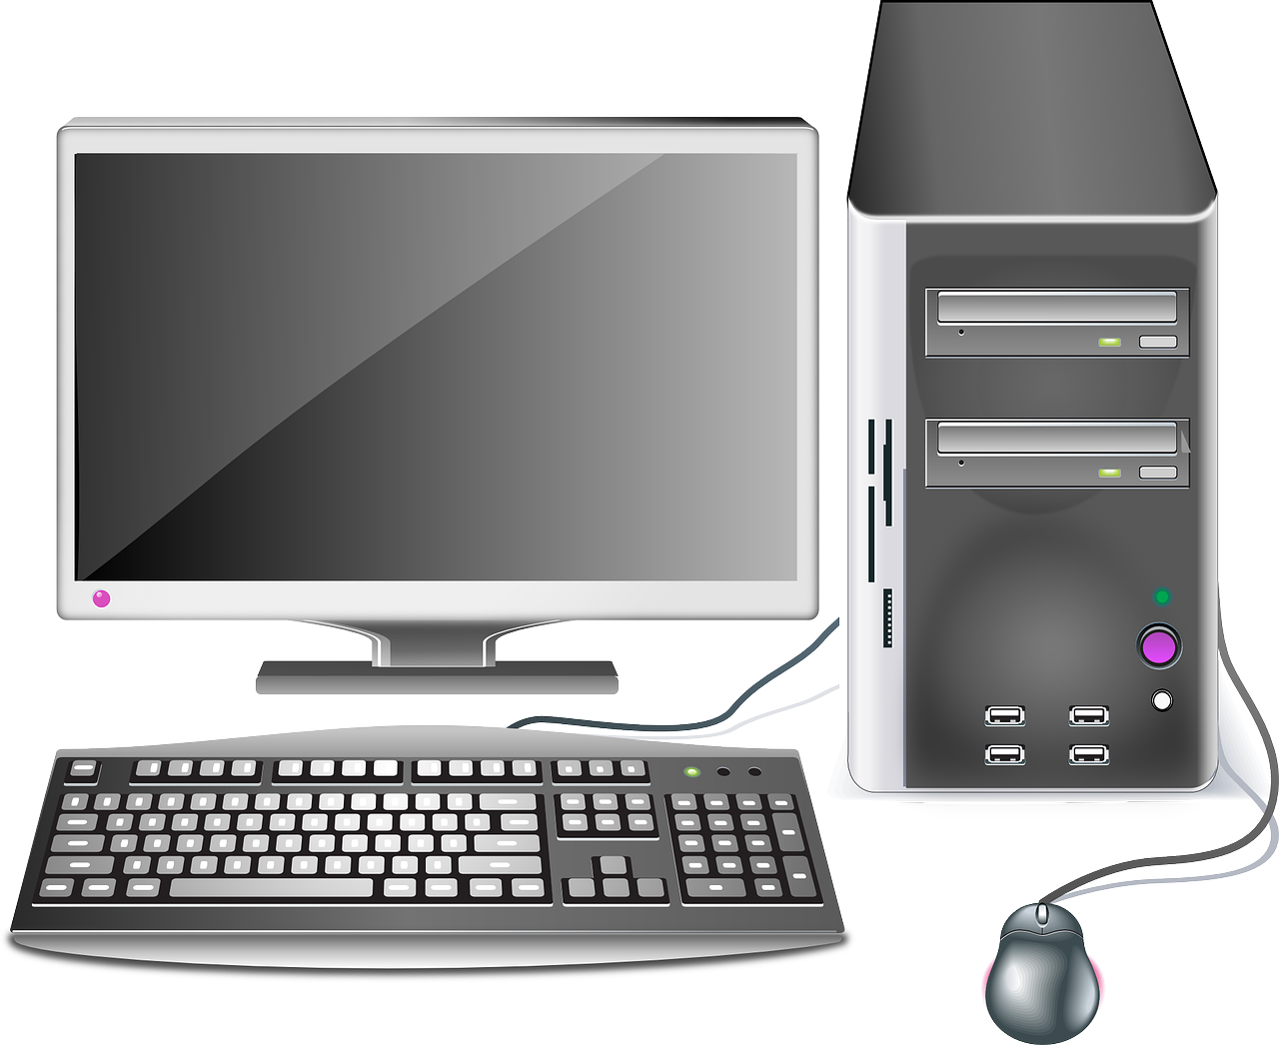
Typical Desktop
Processor | 8-core CPU, clock speed 3.0GHz, 12MB cache
Memory | 8GB RAM
Storage | 512GB SSD (solid-state disk) 1TB HDD (hard disk drive)
Communication | Ethernet (wired) Wi-Fi, Bluetooth (wireless)
Graphics processor | Advanced gaming GPU Over 1000 cores and 6GB memory
Source: Pixabay

Slide 4
Typical Desktop
Expansion slots | Hard disk slots Memory slots Expansion slots (e.g. for sound or graphics cards)
Connections | Ports for video output (screens) Ports for sound input and output (microphone, speakers) Ports for other devices (through USB)
Power | 225W via power connectors (460W power supply)
Software | Operating system Productivity software (office suite) Security software
Source: Pixabay

Slide 5
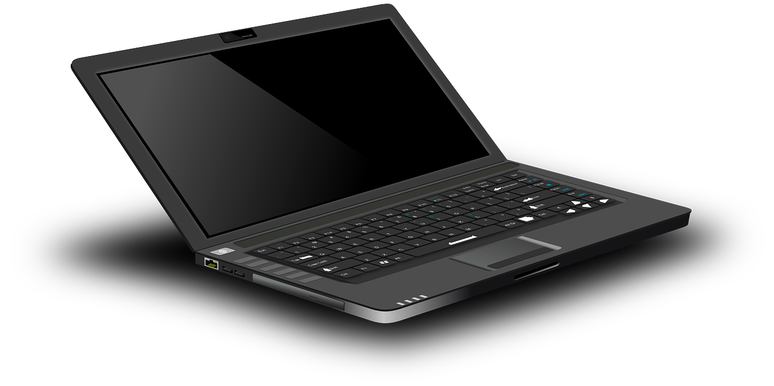
Typical Laptop
Processor | 4-core CPU, clock speed 1.6GHz, 6MB cache
Memory | 8GB onboard RAM
Storage | 256GB SSD (solid-state disk)
Communication | Wi-Fi, Bluetooth (wireless)
Graphics processor | Integrated GPU
Video | 13.3" IPS multitouch display, 1920 x 1080 Camera
Source: Pixabay

Slide 6
Typical Laptop
Sound | Microphone and speakers
Connections | Ports for video output (screens) Ports for sound input and output (microphone, speakers) Ports for other devices (through USB) Slot for storage (SD card)
Power | 60Wh lithium-ion battery
Weight | 1.2kg
Software | Operating system
Source: Pixabay

Slide 7
Typical Mobile Phone
Processor | 8-core CPU, clock speed 2.3GHz Includes an integrated neural processing unit
Memory | 8GB onboard RAM
Storage | 512GB
Communication | Wi-Fi, Bluetooth, NFC, MHL (wireless) GSM, 3G, 4G (mobile telephone network)
Graphics processor | Integrated GPU
Video | 5.4" display, 3040 x 1440 Front and rear cameras
Source: Pixabay

Slide 8
Typical Mobile Phone
Sound | Microphone and speakers
Sensors | Accelerometer, ambient light, barometer, compass, fingerprint, gyroscope, heart rate, magnetometer, proximity
Navigation | GPS, GLONASS, Galileo
Connections | Ports for sound input and output (microphone, speakers) Ports for other devices (through USB) Slot for storage (SD card)
Power | 12Wh battery
Weight | 150g
Software | Operating system for mobile devices
Source: Pixabay

Slide 9
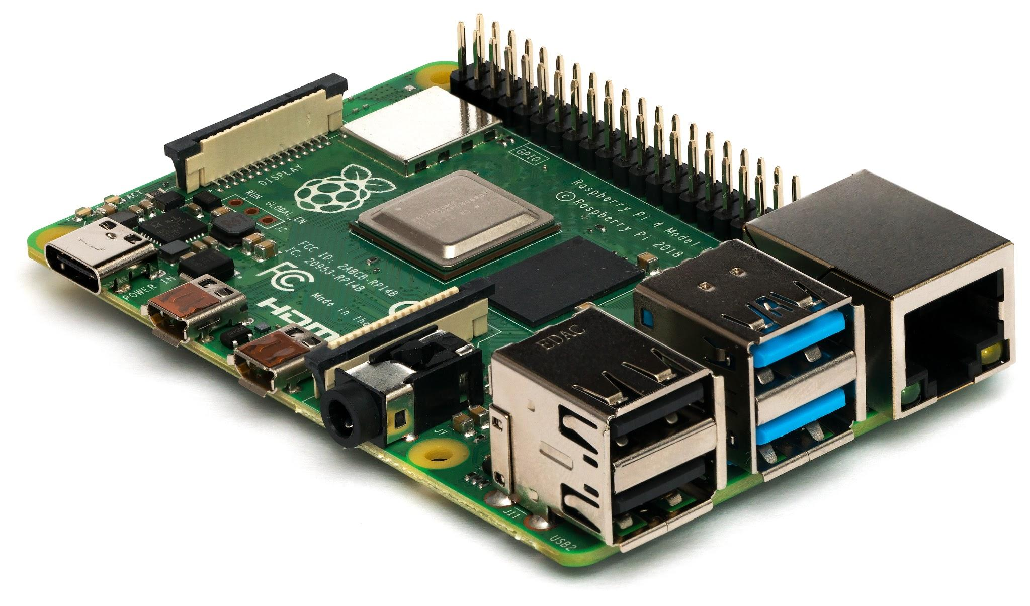
Raspberry Pi 4
Processor | 4-core CPU, clock speed 1.5GHz
Memory | 4GB onboard RAM
Storage | No onboard storage Uses SD card for software and data storage
Communication | Ethernet (wired) Wireless LAN, Bluetooth (wireless)
Graphics processor | Integrated GPU
Sources:
https://www.raspberrypi.org/products/raspberry-pi-4-model-b/specifications/
https://en.wikipedia.org/wiki/Raspberry_Pi

Slide 10
Raspberry Pi 4
Connections | Standard 40-pin GPIO header Ports for video output (screens)Port for video input (camera slot) Ports for sound input and output (microphone, speakers) Ports for other devices (through USB) Slot for storage (SD card)
Power | Via 5V USB-C connector or GPIO header
Weight | 46g
Sources:
https://www.raspberrypi.org/products/raspberry-pi-4-model-b/specifications/
https://en.wikipedia.org/wiki/Raspberry_Pi

Slide 11
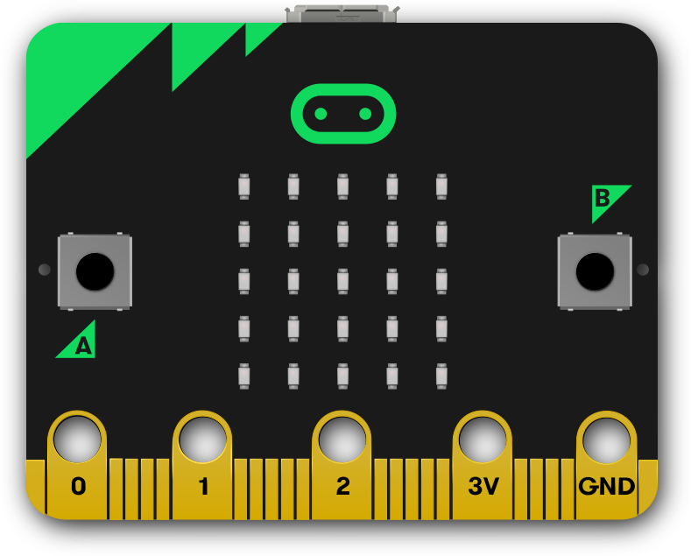
micro:bit
Processor | Single application processor, clock speed 16MHz
Memory | 16kB onboard RAM
Storage | 256kB
Communication | Bluetooth, Low Level Radio (wireless)
Display | 5x5 red LED matrix
Buttons | 2 tactile user buttons, 1 tactile system button
Sources:
https://tech.microbit.org/hardware/
https://en.wikipedia.org/wiki/Micro_Bit

Slide 12
micro:bit
Sensors | Ambient light, accelerometer, magnetometer, temperature
Connections | 3 input/output rings, 2 power rings
Power | Via USB connection, the interface chip, or a battery
Weight | 5g
Sources:
https://tech.microbit.org/hardware/
https://en.wikipedia.org/wiki/Micro_Bit

Slide 13
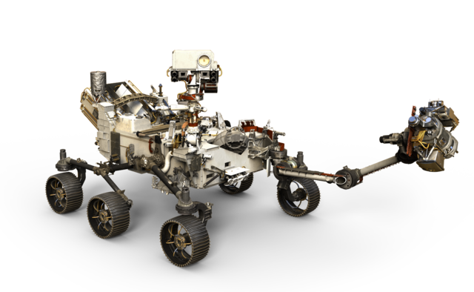
Perseverance rover: Mars 2020 mission
Processor | Radiation-hardened CPU, clock speed 110MHz
Memory | 256MB onboard RAM
Storage | 2GB + 256kB EEPROM
Communication | Ultra-high frequency antenna X-band high-gain antenna (transmission) X-band low-gain antenna (reception)
Sources:
https://mars.nasa.gov/mars2020/spacecraft/rover/brains/
https://en.wikipedia.org/wiki/Perseverance_(rover)
Image source:
https://mars.nasa.gov/resources/mars-2020-rover-artists-concept/

Slide 14
Perseverance rover: Mars 2020 mission
Video | 23 cameras
Audio | 2 microphones
Sensors | Inertial Measurement Unit (IMU) A range of instruments for measurements and scientific experiments
Power | Radioisotope power system 2 lithium-ion rechargeable batteries
Software | Real-time operating system Flight software Surface operations software
Sources:
https://mars.nasa.gov/mars2020/spacecraft/rover/brains/
https://en.wikipedia.org/wiki/Perseverance_(rover)
Image source:
https://mars.nasa.gov/resources/mars-2020-rover-artists-concept/

Slide 15
Task 1 - Complete the table
 | Desktop | Laptop | Mobile | Raspberry Pi 4 | micro:bit | Rover
Processor | ✓
Memory | ✓
Storage | ✓
Communication | ✓
Graphics processor | ✓
Input and output
Connections | ✓
Weight

Slide 16
Task 1 - Similar components - part 2
What are the components that are present in every one of these computing systems?

Slide 17
Task 2 - Wearable computing
The image on the next slide shows several different hardware components of a wearable computing system called Google Glass. Label each component using one of the labels provided below.
Input
Output
Program execution
Data exchange with other systems
Program & data
(volatile storage)
Program & data (persistent storage)

Slide 18
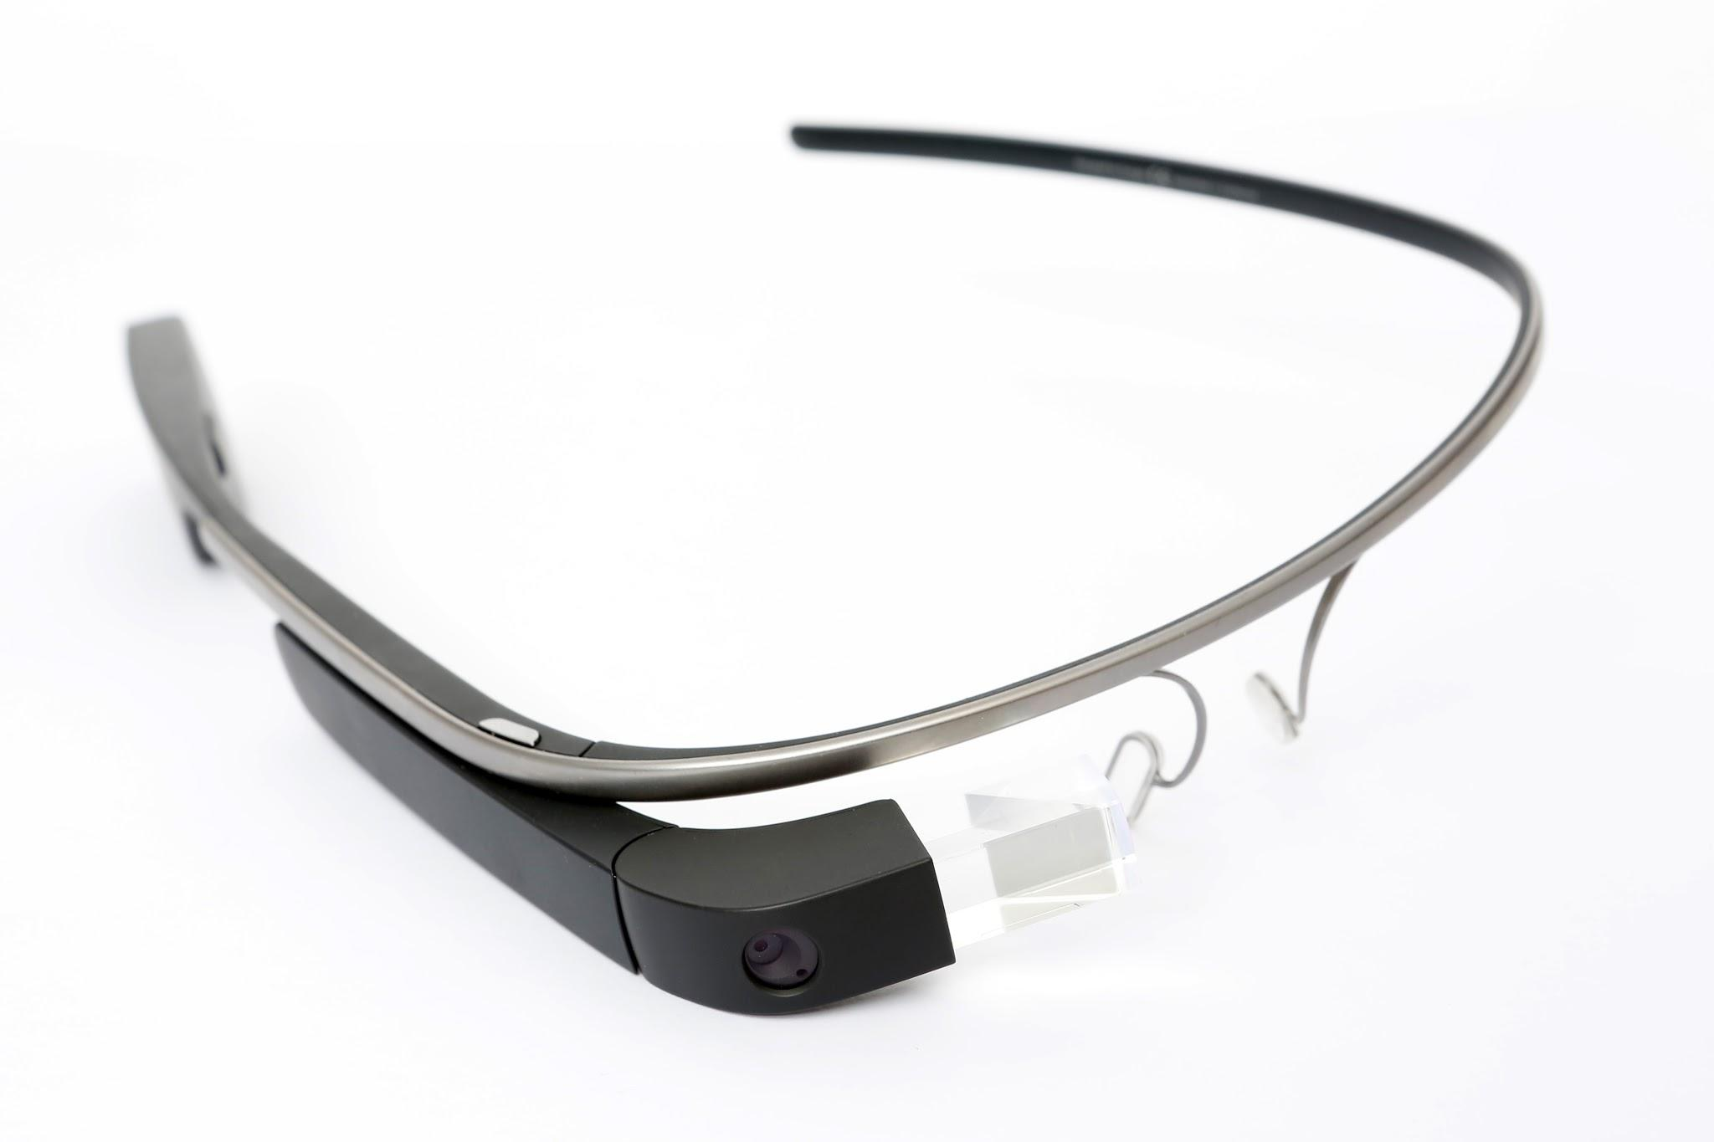
Task 2 - Wearable computing - part 2
Memory
Storage
Speaker
Processor
Communication
Google Glass Main
Source: Wikimedia
Touchpad
Camera
Screen
Sensors
Microphones

